Slide 1
IB Psych 10/06/17
Turn in:
Nothing
Take out :
Planner
Writing Implement
Notes…
Learning Outcomes Chart
Today’s Learning Objectives:
I can describe the areas and function of the brain.
Today’s Agenda:
Principles of the BLOA (Bio Approach)
HW:
CRA 2.4
SAQ Practice—due Monday

Slide 2
SAQ PRACTICE
Choose One
1. Outline [one] principle(s) that define(s) the biological level of analysis. [8 marks]
2. Explain how [one] principle(s) that define(s) the biological level of analysis may be demonstrated in research. [8 marks]

Slide 3
Principles of the BLOA
PRINCIPLE #2
Behavior is the product of the interaction of our physiology and the environment
Raine, et al. (1997)
Newcomer, et al. (1999)

Slide 4
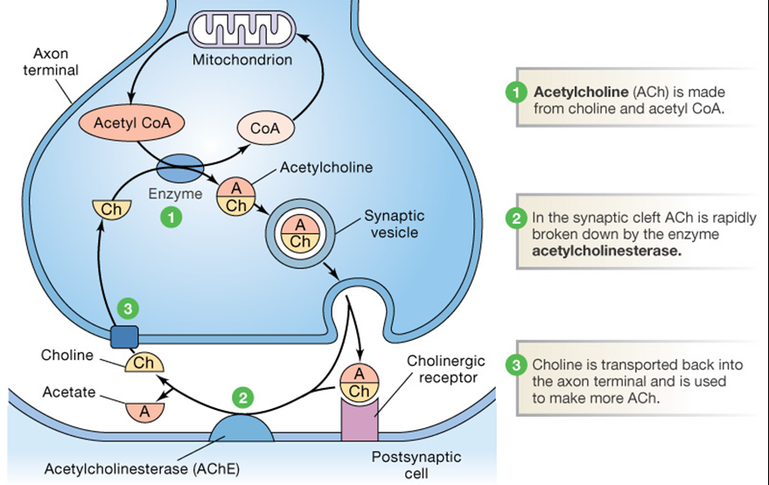
Principle #2: There are biological correlates of behavior
Implies that it should be possible to find a link between a specific biological factor (ex: hormone or neurotransmitter) and a specific behavior
THIS IS ONE OF THE AIMS OF RESEARCHERS IN THIS LOA/APPROACH
EX: Acetylcholine (ACh)
Too much: Parkinson’s
Not enough: Alzheimer’s

Slide 5
Principle #2
Examples of neurotransmitters & hormones that are in charge of really important things:
Acetylcholine (NT): contracts smooth muscles, dilates blood vessels, increases bodily secretions, and slows heart rate.
Dopamine (NT): helps control the brain's reward and pleasure centers.
Serotonin (NT): is considered a natural mood stabilizer. It’s the chemical that helps with sleeping, eating, and digesting.
Growth Hormone (Somatotropin): in control of several complex physiologic processes, including growth and metabolism
Leptin (Hormone): the "satiety hormone“; helps to regulate energy balance by inhibiting hunger.
Ghrelin (Hormone): regulating appetite, ghrelin also plays a significant role in regulating the distribution and rate of use of energy.

Slide 6
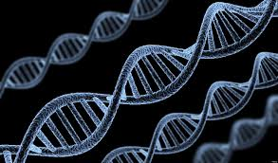
Principles of the BLOA
PRINCIPLE #3
Behavior can be inherited (and innate) because it is genetic
Bouchard, et al. (1990)
Bailey and Pillard (1990)

Slide 7
Principle #3: Behavior can be inherited because it is genetic
TWIN STUDIES
Why study twins?
What are Monozygotic twins?
Dizygotic twins?
Diathesis-Stress Model
Genetic predisposition (diathesis) to develop a disorder that MAY OR MAY NOT be brought out by the environment (stress)

Slide 8
Studies mentioned thus far…you could use, or use others from the text…
Meany, et al. (1988)
To determine the effect of glucocorticoids (stress hormones) on memory.
Newborn Rats and a maze…
Rosenzweig, Bennet, and Diamond (1972)
changing the level of stimuli in the environment would result in physical changes in the brain.
Rats with varying conditions in cages
Raine, et al. (1997)
Using PET scans to determine if charged murders, but pleading NGRI show physical differences in the brain
Newcomer, et al. (1999)
investigate whether high levels of the stress hormone cortisol interfere with verbal declarative memory.
Human participants
Bouchard, et al. (1990) “Minnesota Twin Study”
Link of genetics and intelligence
Bailey and Pillard (1990)
Role of genetics and sexual orientation
Twin study (both MZ and DZ)

Slide 9
Studies mentioned thus far…you could use, or use others from the text…
Class code for all classes: STUDENT.THINKIB.NET/GROUP/ADQ2458
Class Accounts …I think I can share info on these studies with you…but access has changed—let’s get signed up and see what we can make work!

