Slide 1
10th World Studies 10.26.17
Turn in:
Nothing
Take out:
Planner
NOTES
PEN…
Today’s objective:
I can describe the meaning of Luther’s 95 Theses and connect the surrounding events to the time period as well as current issues.
Today’s Agenda:
The Counter-Reformation
HW:
Exam: Thursday(?)—Nope…Friday it is!
In-class: Outline Notes—13.4, beginning with “The Catholic Reformation” (431)

Slide 2
Inquisitions
AUTO DE FE—Act of Faith
Would convict but not sentence, sentences were carried out by secular authorities, particularly death
"... for punishment does not take place primarily and per se for the correction and good of the person punished, but for the public good in order that others may become terrified and weaned away from the evils they would commit.”

Slide 3
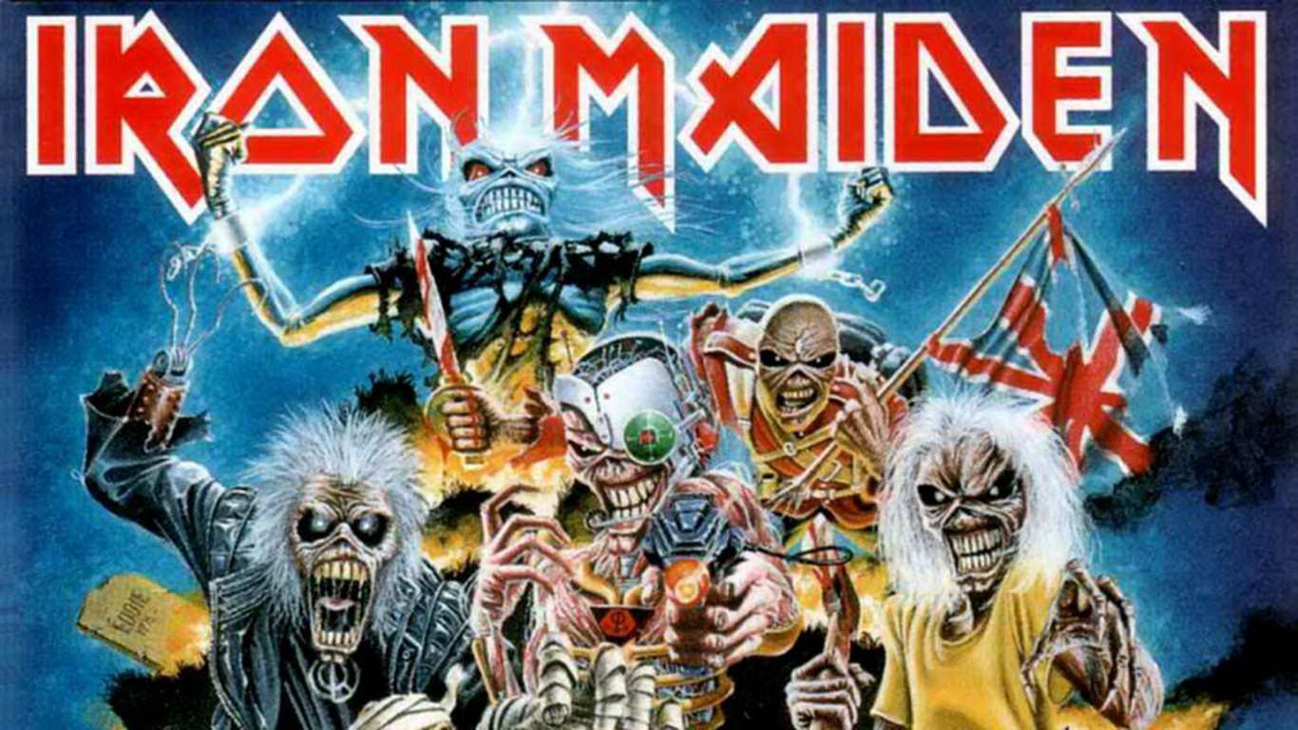
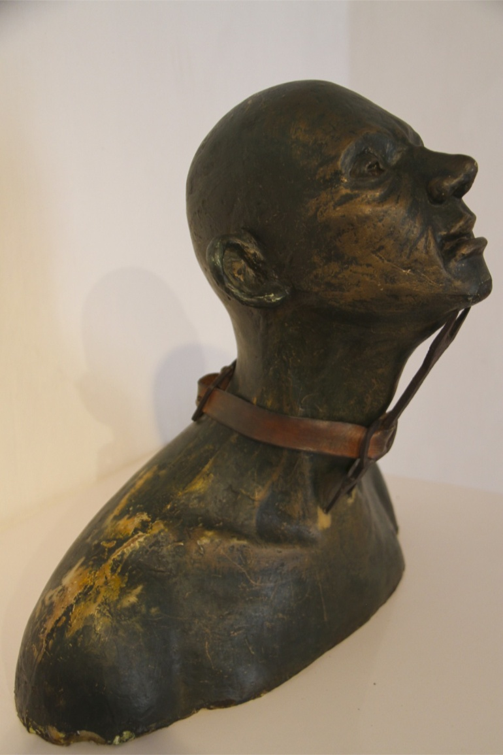
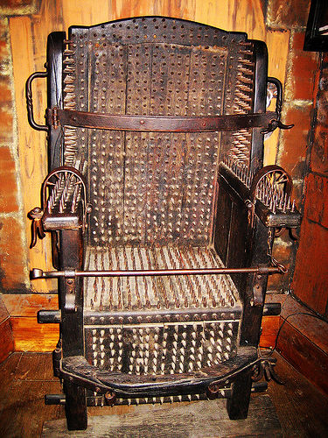
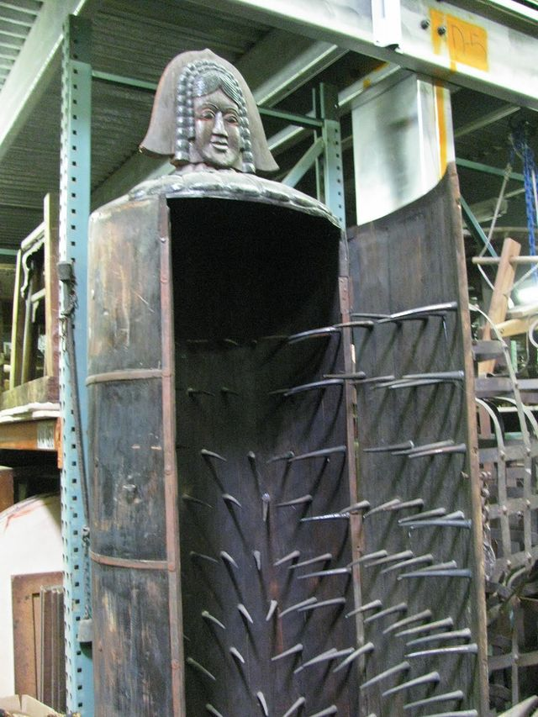
In Spain alone, several thousand people were executed usually by burning at the stake (or strangulation)…but there were other methods.

Slide 4
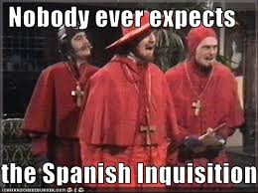
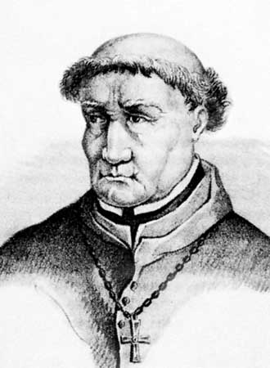
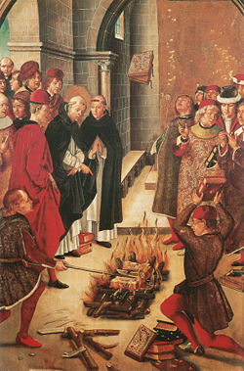
METHOD: Inquisitions
THE INQUISTION: https://www.youtube.com/watch?v=5ZegQYgygdw
The most famous …
The Spanish Inquisition (1478–1834)
Led by Torquemada
Confessor of the Queen
https://www.youtube.com/watch?v=7WJXHY2OXGE&list=RD7WJXHY2OXGE&index=1

Slide 5
Results of the Counter-Reformation
Reformers within the Catholic Church, like the Jesuits, were stern (No more fun-loving Popes like in Renaissance Era)
Slow to react at first to the Reformation, the Church under its harsh new leaders cracks down on heretics.
In the end, though the Church had to accept the religious division of Europe, Catholicism emerged stronger than ever in the areas that it still controlled.

Slide 6
So, all is right with the world after the Counter/Catholic Reformation…right?!?
In France more than 10,000 Protestants killed following the St. Bartholomew’s Day massacre in 1572 (we’ll talk about this again…)
Spain fought bloody wars against Protestants in the Spanish Netherlands (Belgium & Luxembourg) in the late 1500s.
Thousands died in the Catholic/Counter-reformation—many at the hand of the Inquisition(s)
Thirty Years War (1618-1648), a bloody Catholic-Protestant fight for control of Germany and central Europe.

Slide 7
Europe torn apart by religious conflict

