Slide 1
10th WORLD Studies 10.31.17
Turn in:
Definition of concept using our critical attributes…(stamp)
Take out:
Planner,
Pen/Pencil,
Stamp Sheet
Notes
Today’s objective:
I can begin to describe the changing political system following the Middle Ages, Renaissance, and Protestant Reformation.
Today’s Agenda:
Concept Formation
Examples of Concept, In-class
More “Examples?”
HW:
NONE

Slide 2
Concept formation STEP #3
Read each of the 4 examples and fill out the chart
* EACH OF THESE IS AN EXAMPLE OF OUR CONCEPT
2. Complete the “Concept Formation Notes”
* ONLY THE SIMILARITIES AND DIFFERENCES
3. Use the critical attributes to create a definition for our concept. “This is a concept where…” or “This concept is…”

Slide 3
OUR definition
This concept is a form of monarchy where all political power is located in a monarch who rules by divine right without any checks or balances on his/her power.

Slide 4
OUR definition
This concept is a form of monarchy where
all political (sovereignty) power is located in a monarch
who rules by (divine right)
(without any checks or balances) on his/her power.

Slide 5
OUR LABEL…
ABSOLUTISM

Slide 6
Concept formation STEP #4
Read each of the 4 examples and fill out the chart
* EACH OF THESE IS AN EXAMPLE OF OUR CONCEPT
2. Complete the “Concept Formation Notes”
* ONLY THE SIMILARITIES AND DIFFERENCES
Use the critical attributes to create a definition for our concept.
* “This is a concept where…” or “This concept is…”
4. Examples and Non-Examples
*Read through “List of Examples”
*For each example decide if it IS or IS NOT an example of Absolutism & EXPLAIN
*If NOT an example, what is missing?

Slide 7
Notes:
BALANCE OF POWER

Slide 8
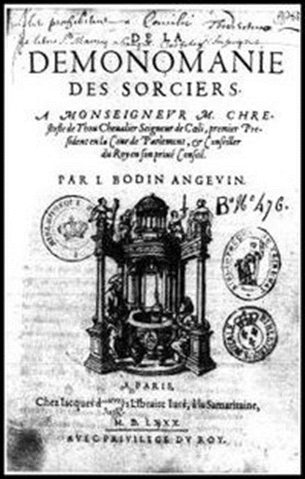
A power vacuum…Why?
-Black Plague and Wars weaken feudal lords
-Renaissance weakens the power of the Catholic Church
-Age of Exploration makes kings rich
-Absolute Power is hereditary
DIVINE RIGHT OF KINGS
The belief that kings get their power
From God, NOT the people
-Jean Bodin: Only absolutism could provide order and force people to obey authority

Slide 9
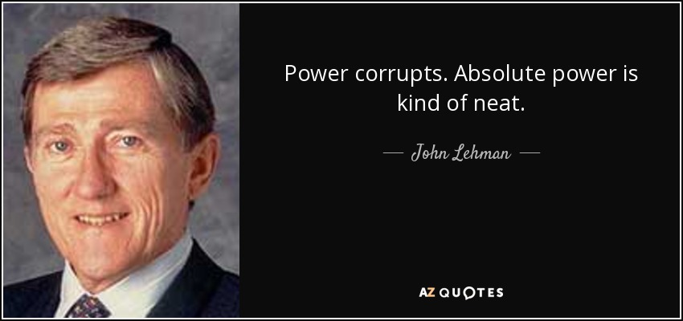
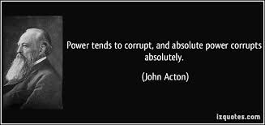
Age of Absolutism
-Age of Exploration = 5 powerful countries/families
*England – The Tudors
*France – The Bourbons
*Spain – The Hapsburgs
*Prussia – The Hohenzollerns
*Russia – The Romanovs
Large Standing armies = Balance of Power in Europe
*No more feudal armies*
Notes:
“The absolute and perpetual power of a Republic”
Centralized Government
Central governments evolved into nation-states
with strict boundaries
with unified role
with permanent armies
Citizens shared:
language
colture
national loyalty
religion (sometimes)

Slide 10
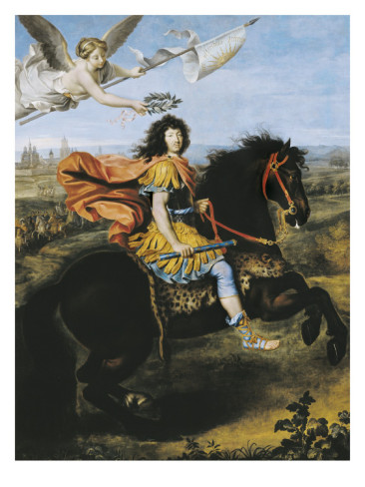
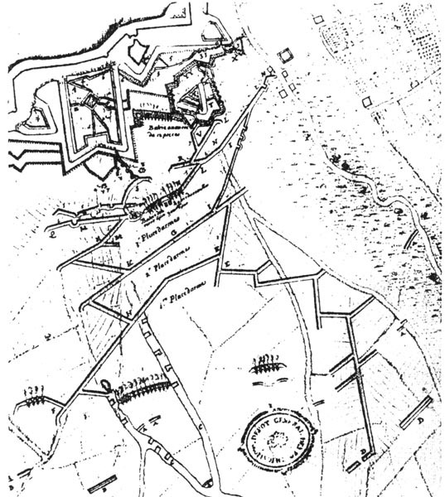
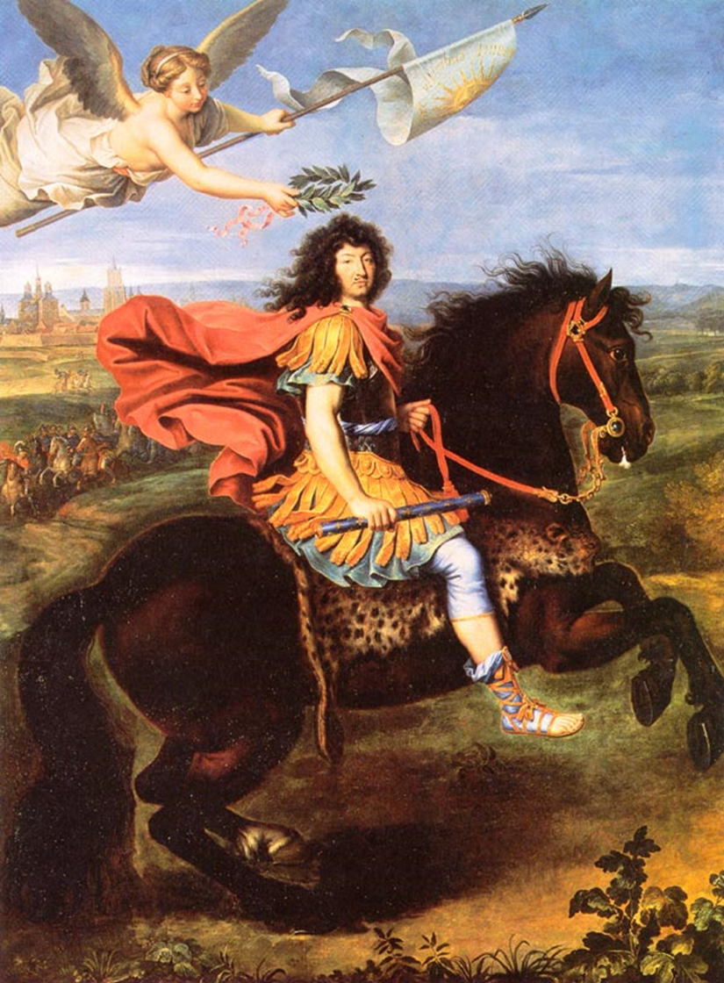
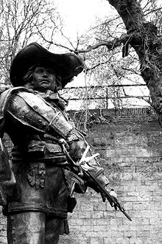
d'Artagnan: of The Three Musketeers fame…was one of the military leaders during the battle—shot in the throat and died… ☹
Map of the Siege: more than 7000 peasants were “asked” to help dig trenches for the engineer of the siege. About 45000 French troops were present…Louis XIV sent all of the high ranking men away toward the end of the siege to help solidify his “power.”
Louis XIV of France being crowned by victory after the 1673 Siege of Maastricht by Pierre Mignard

Slide 11
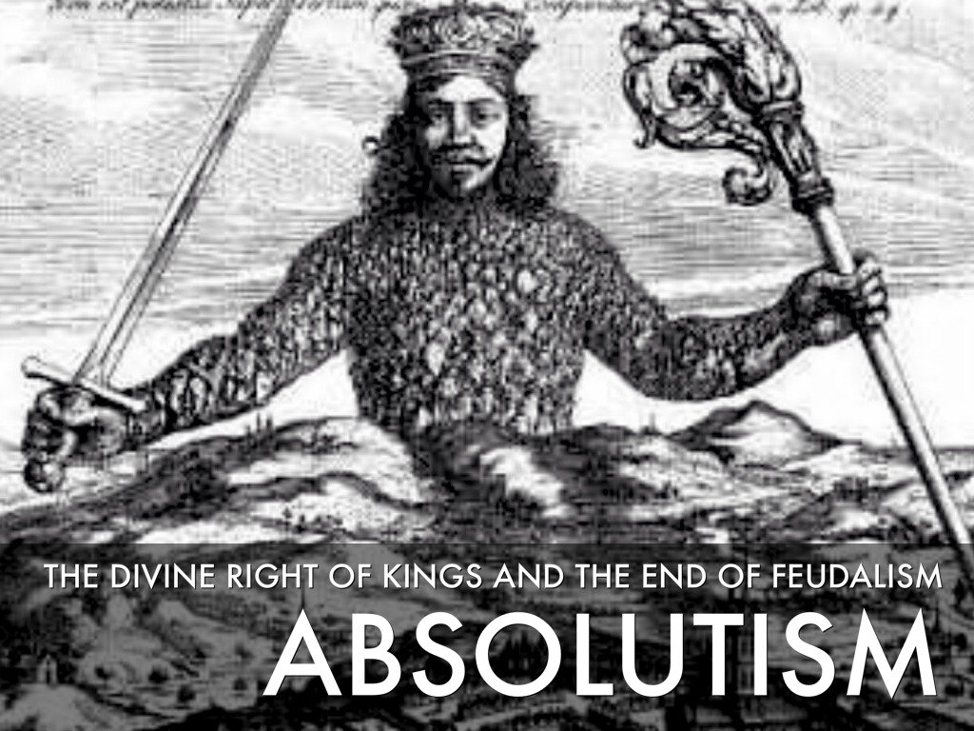
1648-1763

Slide 12
Let’s look at more in-depth examples
The king lives in extravagance…his subjects in squalor…in fact, one of the poorest nations in the world of the time.
He has taken 13 brides—at the same time…
The nation’s production of sugar cane makes him incredibly wealthy…but not the people.
Relative peace has existed for decades, but many subjects live in poor health and have high rates of death, due to lack of adequate food sources.
Nearly 1/3 of the nation’s children have lost at least one parent.
Parliament has been dissolved…but they have a constitution.
Is this an example of Absolutism? Where in the time period do you think this might be taking place?

Slide 13
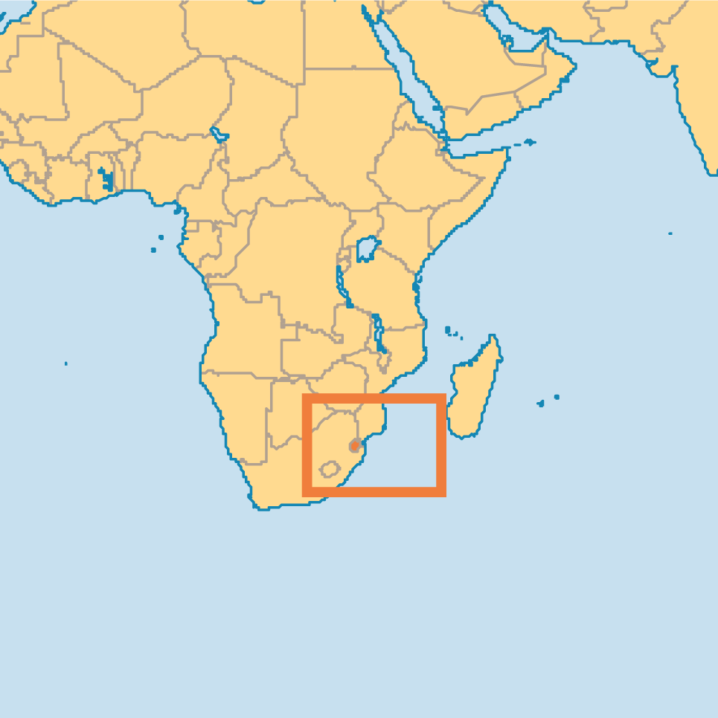
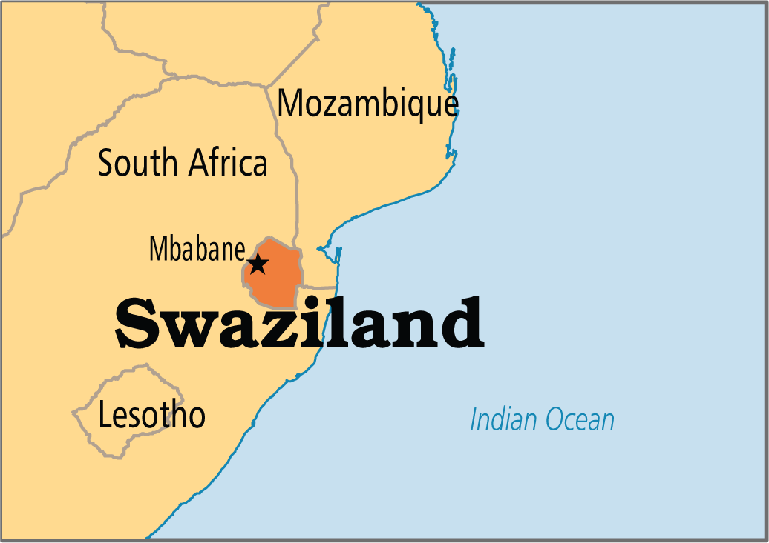
Let’s look at more in-depth examples
Mswati III, King of Swaziland

Slide 14
Europe torn apart by religious conflict following the Reformation(s)

Slide 15
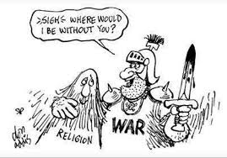
Religious strife
In France more than 10,000 Protestants killed following the St. Bartholomew’s Day massacre in 1572 (we’ll talk about this again…)
Spain fought bloody wars against Protestants in the Netherlands in the late 1500s.
Thousands died in the Catholic Counter-reformation—many at the hand of the Inquisition(s)
Thirty Years War (1618-1648), a bloody Catholic-Protestant fight for control of Germany and central Europe.

