Slide 1
IB Psych 11/07/17
Turn in:
Nothing
Take out :
Planner
Writing Implement
Notes
Today’s Learning Objectives:
CLOA 1-12
Today’s Agenda:
Donder’s Subtraction Method
CLOA Intro
Principles
HW:
None

Slide 2
Shall we play a game?
Partner up with someone NOT at your table group…determine who is partner #1 & partner #2
Partner 1—you will write a “C” over every capitalized letter
Partner 2—you will time partner 1 (Record the time…) Switch!
Partner 1—put a C over every capitalized consonant, and a V over every capitalized vowel. Vowels are A, E, I, O, and U. No w's or Y's have been capitalized in order to avoid confusion.
Partner 2—you will time partner 1 (Record the time…) Switch!
Partner 1—put a C over every capitalized consonant, and a V over every capitalized vowel. However, if the capitalized vowel is an E, please put an X over the letter.
Partner 2—you will time partner 1 (Record the time…) Switch!
LET’S CHART THE RESULTS…

Slide 3
Donder’s Subtractive Method
Differing levels of cognitive tasks:
a simple reaction time task
a discrimination reaction time task
a choice reaction time task
The hypothesis was that at each level of task, the amount of time needed in order to complete the task would increase…let’s compare to our results.

Slide 4
Principles of Cognitive Level of Analysis
Mental process can and should be studied scientifically
(1A. Humans are active information processors.)
Mental representations/process guide behavior

Slide 5
Mental processes can and should be studied
Viewing mental processes in terms of information-processing has made it possible to formulate testable theories about unobservable cognitive structures and process
Such models or theories can be tested by conventional scientific methods (laboratory experiments, brain-imaging studies) without having to rely on introspection for data collection

Slide 6
Mental Representations Guide Behavior
SCHEMA
From the Greek, “skhema” meaning “form” or “figure”
A mental representation of knowledge…
Mental structures which organize our knowledge…
Viewing “reality” through the lens of our schema…

Slide 7
Let’ Experiment
Simple directions…
Are you ready…
Draw a boat.
60 seconds…GO!

Slide 8
Next step
Share with your partner(s)
What kind of boat did you draw?
Why did you draw that boat?
What do you notice about your drawings?

Slide 9
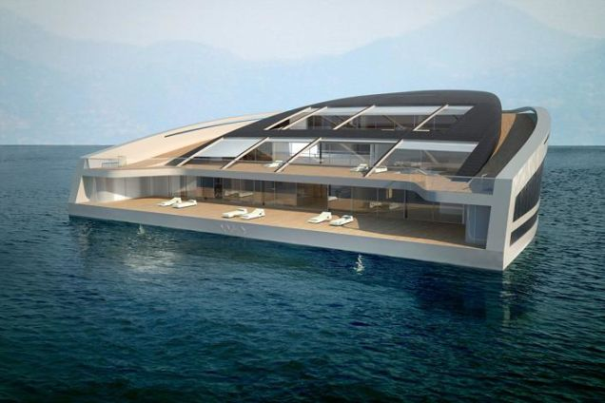
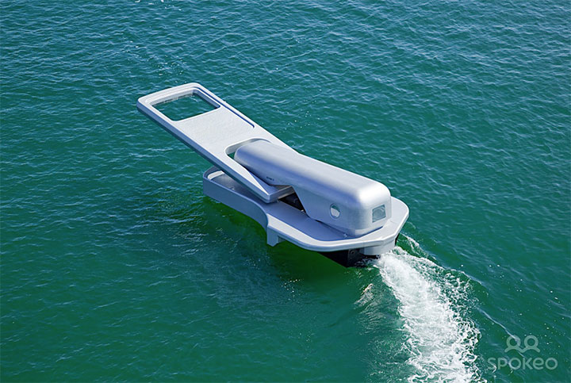
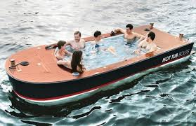
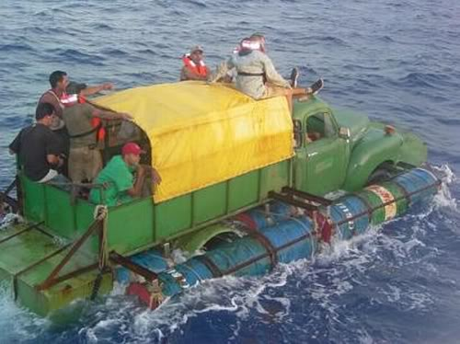
Is this the boat you pictured in your MIND?

Slide 10
Your boat…
What is the point?
What does your background have to do with what shape(s) you drew?
Do you have experiences with a boat?
Do you spend time on a boat?
Think of schema as your previous knowledge…based on what?!?
Uhhh, everything…

