Slide 1
10th Euro Studies 11.7.17
Turn in:
CRA 16.5 (stamp)
Take out:
STAMP SHEET
Planner
Pen/pencil,
NOTES
Monarch Chart, Map of Europe
Today’s objective:
I can describe how England’s history of monarchs differs from other European nations during Absolutism.
Today’s Agenda:
England: (End of Tudors) Stuart
James I
Charles I
Oliver Cromwell
Charles II
James II
William and Mary
HW:
Let’s see how it goes…who am I kidding—no HW

Slide 2
The English Civil War, Restoration and Glorious Revolution

Slide 3
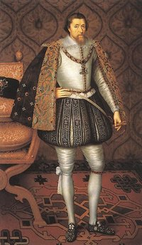
James (VI) I (Stuart)
James I (rule 1603 – 1625)
Took over for Elizabeth I (The last of the Tudors…even though James is Henry VII’s GG Grandson)
“The state of monarchy. . . is the supremest thing upon earth: for Kings are not only God’s lieutenants upon earth, and sit upon throne, but even by God himself they are called Gods.”
“ Kings are justly called gods, for that they exercise a manner or resemblance of divine power upon earth.”
Responsible for King James Version of the Bible
We should remember him from our DROK discussion…(and Macbeth!)

Slide 4
James (VI) I (Stuart) 1603-25
C’mon, man! Why two sets of Roman numerals again?!?
Check out the dates…connection to anything in LA???
Elizabeth I never married…meaning there is no “issue,” right?
James VI of Scotland…becomes James I of England
Son of Mary Queen of Scots—Scottish Rebellion (beheaded as a threat to the Catholic Church in England)
1605—Gunpowder Plot (Jesuit Treason)
We should remember him from our DROK readings…

Slide 5
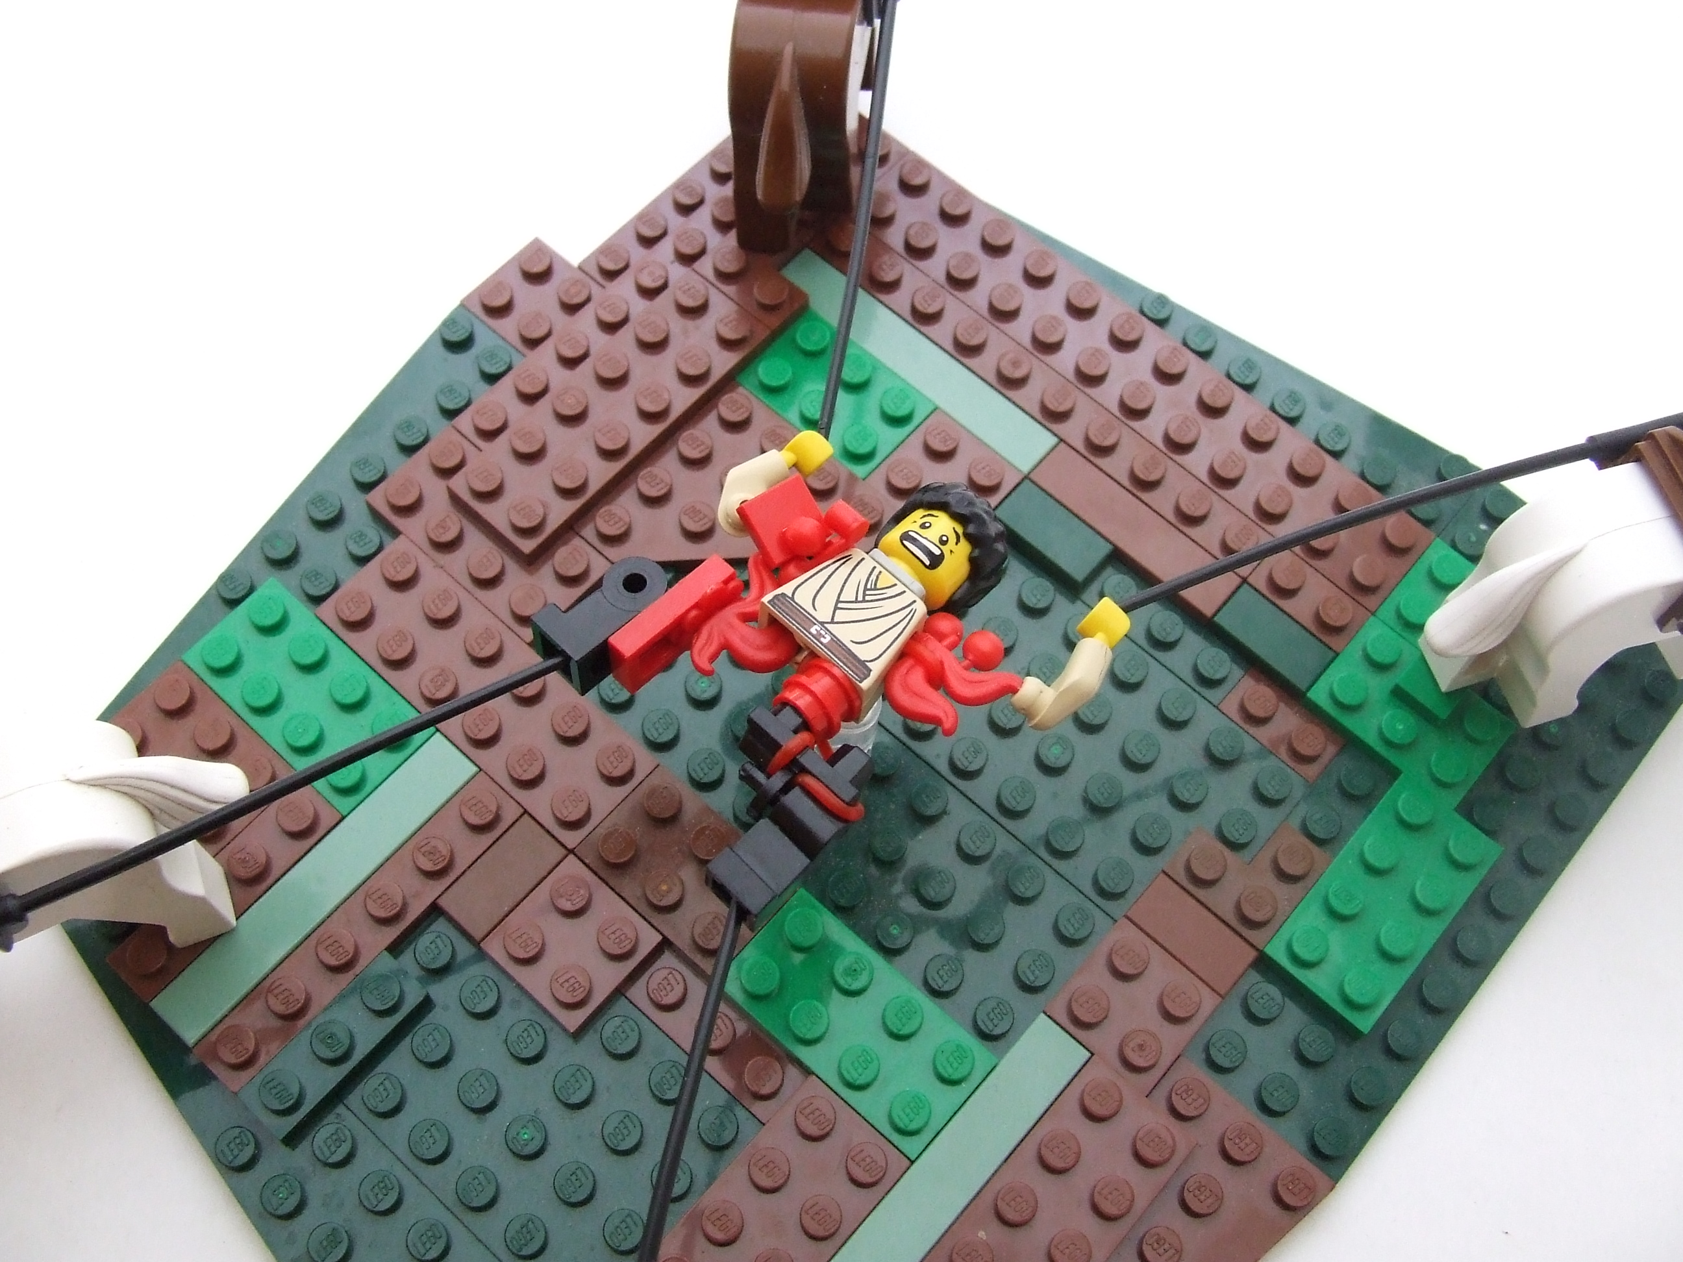
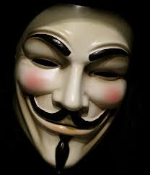
Gunpowder Plot
“Remember, remember the 5th of November”
1605—Gunpowder Plot (Jesuit Treason)
Guy Fawkes Background
Fought for Catholic Spain in the 80 Years War
Spanish Netherlands
Petitioned Philip III to wage war against England and the “heretic” on the throne.
To be “Drawn and Quartered” (soooo Medieval!) but why?!?
1606—a public day of thanksgiving
The Thanksgiving Act (repealed in 1859)
"And to the End this unfeigned Thankfulness may never be forgotten, but be had in a perpetual Remembrance, that all Ages to come may yield Praises to his Divine Majesty for the same, and have in Memory this joyful Day of Deliverance...”

Slide 6
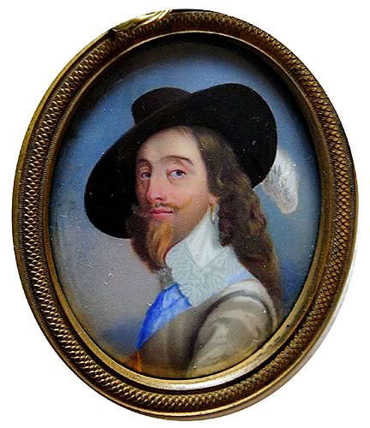
Charles I
Son of James
Took over for James in 1625
He needs money to fight wars,
but Parliament won’t give it to him. He dissolves it.
1628- He really needs money. Parliament forced him to sign the Petition of Right, a document that granted rights to citizens
King could not imprison people without just cause, levy taxes without parliament’s consent, quarter soldiers in private homes, impose martial law (military rule) in peacetime
Any of those rights sound familiar?!?

Slide 7
After the P.O.R.
Charles signs the P.O.R. and then does not honor it.
If he agrees to the P.O.R. he would be admitting that the law is more powerful than him.
Refuses to call Parliament
Taxes the people heavily
Makes many enemies

Slide 8
English Civil War
Charles I tries to get Scottish to follow Anglican Prayer Book—KJB issue perhaps?
Scots get mad, form an army, threaten to invade England
Charles needs money to fight the Scots
He can only get money by calling Parliament
Parliament hasn’t been called for 11 years

Slide 9
The Long Parliament
Parliament meets from 1640-1653
Parliament tries to pass laws limiting the power of the King
This makes Charles mad
He tries to arrest several leaders of Parliament, but they escaped
People of London get angry—let’s get him!!!
Charles flees to Northern England to raise an army

Slide 10
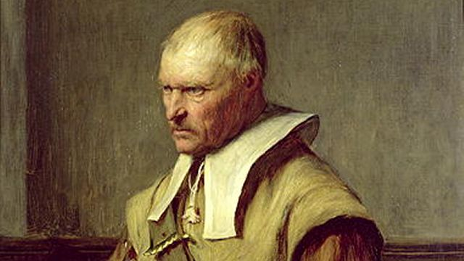
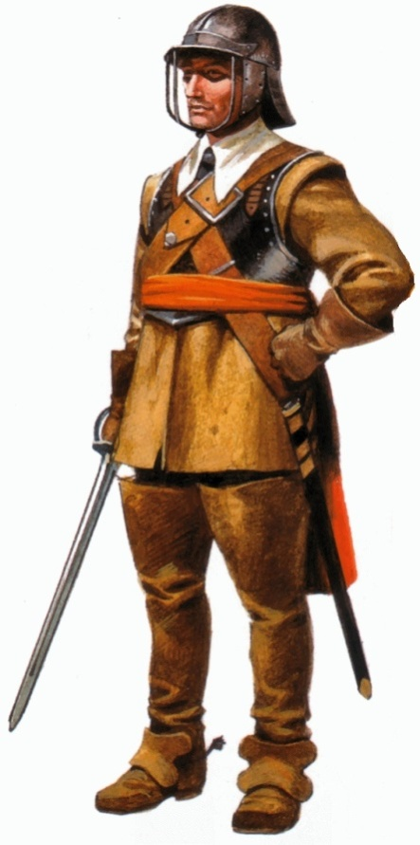
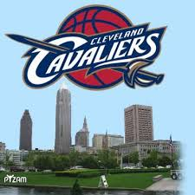
English Civil War (1642-1649)
2 sides
Royalists—Cavaliers were loyal to the King
Wealthy nobles, Flashy, long haired
Parliamentarians—Roundheads
Were Puritan supporters of Parliament
Working class, middle class and Puritans

Slide 11
Oliver Cromwell and the New Model Army
Parliament forms a professional group of soldiers in February of 1645
Very well disciplined
Promotions based on merit, not class
Most members had strong Puritan values—many saw as extremists
No drinking, cussing, women, gambling, etc.
Cavaliers eventually beaten by New Model Army

Slide 12
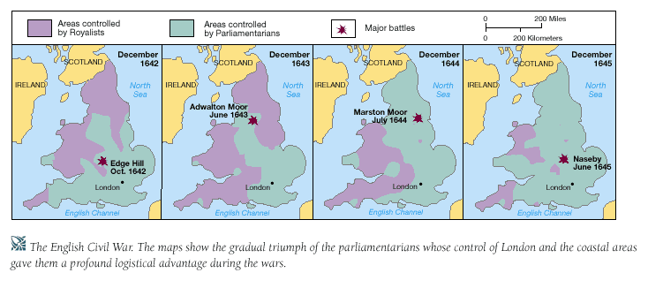
Ironically, Charles flees to Scots for help…they sell him to English Parliament!

Slide 13
The King is executed
Parliament tries King Charles I for being a “tyrant, traitor, murderer, and public enemy.”
Was beheaded in January of 1649
Sent shock waves throughout Europe
If a monarch in England can be killed, a monarch can be killed in any country.

Slide 14
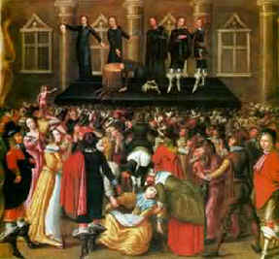
The Execution of Charles I
1. https://www.youtube.com/watch?v=tqCFSg5xSw4
2. https://www.youtube.com/watch?v=IPmSR--BktE

