Slide 1
10th World Studies 11.09.17
Turn in:
16.3 (Stamp)
Take out:
Planner,
Pen/pencil,
Monarch Chart, Map of Europe
NOTES
Today’s objective:
I can describe how England’s history of monarchs differs from other European nations during Absolutism.
Today’s Agenda:
England: (End of Tudors) Stuart
James I
Charles I
Oliver Cromwell
Charles II
James II
William and Mary
HW:
None

Slide 2
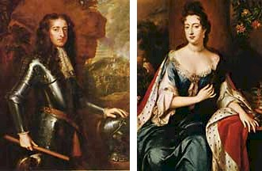
William III of Orange and Queen Mary
(rule 1689 – 1702)

Slide 3
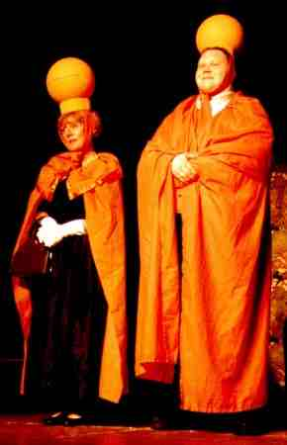
The Glorious
(and bloodless)Revolution
Parliament invites James II Protestant daughter, Mary and her husband William to rule England
But…they must obey parliament’s wishes
They accept James II flees (they did bring a large army with them…)
Divine Right to Rule is DEAD (in England)!
Will & Mary sign Bill of Rights to signal their “okay”

Slide 4
We, William and Mary
Of Orange
Do hereby recognize
Parliament as the
Real power

Slide 5
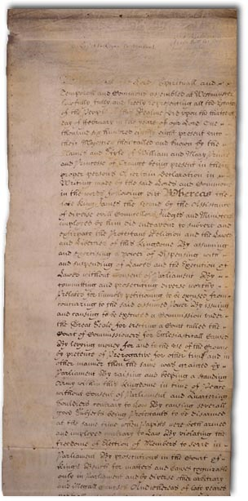
English Bill of Rights(1689)
Ratified revolution of 1688
Ensures that Parliament will now and forever be superior to the monarchy
King had to call parliament regularly
Parliament controlled spending
King couldn’t interfere with Parliament or dissolve it
No Catholic could sit on the throne
Trial by Jury
No excessive fines or cruel and unusual punishment
Habeas corpus- couldn’t throw someone in jail without charging them with a specific crime

Slide 6
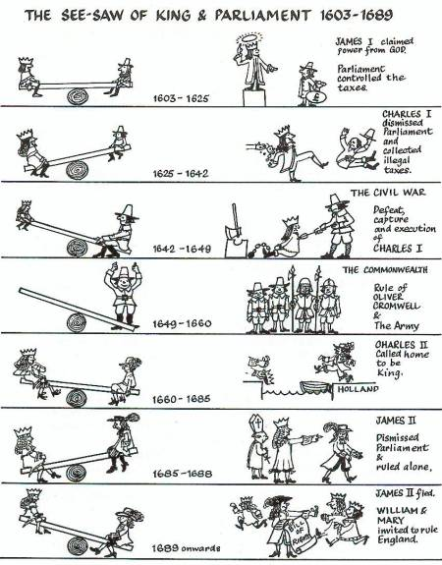

Slide 7
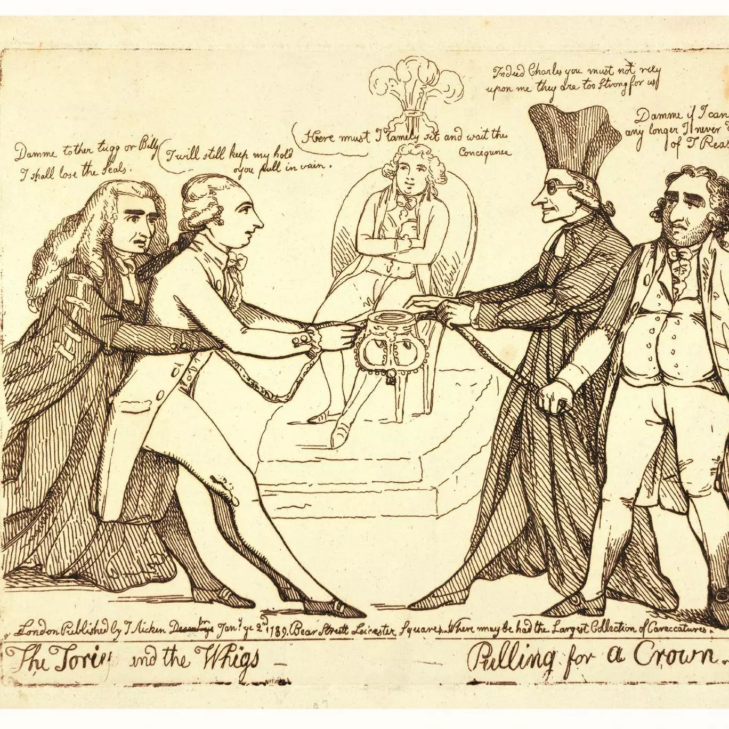
These issues over how power is wielded is in response to the fear instilled by one word:
Tyranny
From Greek tyrannia “rule of a tyrant, absolute power,” from tyrannos “master.”
This also originated the division of British politics through the time of the American Revolution.
Whigs:
Those that were opposed to Catholic rule/influence, as well as absolute monarchy
Tories:
Those that were loyal to the power of the crown, and the RMC (Church)

Slide 8
England is now a Constitutional/limited monarchy
Absolute Monarchy- monarch who has complete authority over the government and lives of the people he or she governs
Constitutional or limited monarchy- monarch whose power is limited by a constitution or legislative body
Created, at least in part, because of the fear that England would become merely a satellite state, under the control of an all-powerful Catholic monarch.

Slide 9
Also led to:
the Bank of England being founded in 1694
greater scrutiny of crown expenditure through parliamentary committees of accounts.
The bureaucracy required to harvest all this money grew exponentially too.
the growth of slavery by ending the Royal African Company’s monopoly on the trade in 1698

Slide 10
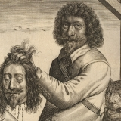
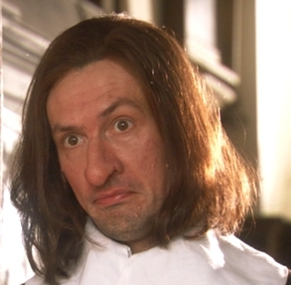
Trial and Execution of Charles I: https://www.youtube.com/watch?v=tqCFSg5xSw4
The Oliver Cromwell Song: https://www.youtube.com/watch?v=dBPf6P332uM

