Slide 1
10th World Studies 11.13.17
Turn in:
Nothing
Take out:
Planner
Pen/pencil
Notes
Monarch Chart & Map of Europe
Internet Device
Today’s objective:
I can determine if I am meeting Steen’s expectations for reading, note-taking, etc.
Today’s Agenda:
An opportunity for you to display your knowledge
Background on France
HW:
CRA 16.2
Exam 11/21

Slide 2
You may use your phones…
We have an online: OPEN NOTES quiz!
You will have 20 minutes to complete and submit: I will only accept your FIRST submission!
I will close the window at 20 minutes: budget your time!
If you finish early, take a peek at the Fall Research Paper button…we’ll look at it more at the end of the week.

Slide 3
Civil War
In France
(1562-1598)

Slide 4
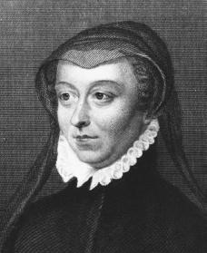
Catherine de Medici
Remember her?!?
The Medici are baaaack…

Slide 5
The Valois Family: The Beginning of the End
Henri II was the last powerful Valois—he died…
Three weak sons followed:
Francis II
Charles IX
Henri III
Catherine de Medici controlled the sons:
Was mother to the boys
Played both sides in the civil war
Developed a reputation for cruelty—sounds like a Medici!

Slide 6
The French Civil War
There were two sides:
Guise family led Catholics in North
Bourbon family led Huguenots in South
Fighting for the royal inheritance
Catherine supported the Guises in the first phase.
Henri III—CdM urged him to make peace…just before she died she learned he didn’t…ironically, he was then assassinated…
St. Bartholomew’s Day Massacre
August 24, 1572
20,000 Huguenots were killed (numbers vary)
Henri of Navarre, a Bourbon, survived

Slide 7
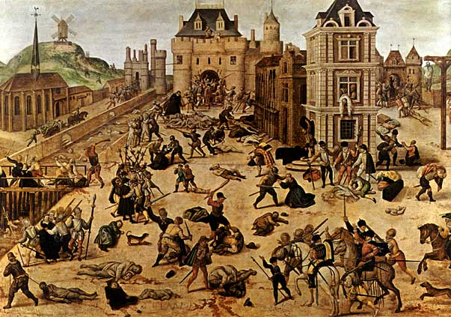
St. Bartholomew’s Day Massacre

Slide 8
The French Civil War
Catherine started supporting the Bourbons.
Henri of Navarre defeated Catholic League & becomes Henry IV of France.
Effects of Civil War:
France was left divided by religion
Royal power had weakened
Valois family now replaced by Bourbons
Catholic League
CIVIL WAR
Protestant Union

Slide 9
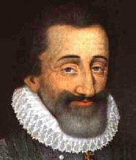
Absolute Monarchy in France
Religious Wars and Power Struggles
Bourbon Family
Henry of Navarre-converted to Catholicism: “Paris is worth a Mass.”
Married Catherine de Medici’s daughter
Phillip II of Spain had refused the offer
Survived the 1572 St. Bartholomew’s Day Massacre (of Huguenots)
Becomes Henri IV
Edict of Nantes (1598)
Henry’s declaration of religious toleration
Allowed Catholics and Huguenots to live in peace
Louis XIII and Richelieu
After Henry died, his son took over
Louis XIII

Slide 10
Louis XIII and Cardinal Richelieu
Louis XIII was a weak king
Had an extremely powerful minister for support-Cardinal Richelieu
Richelieu took two major steps towards power
Moved against the Huguenots and all Protestants
Weakened the Nobles power and relied on the middle class instead

Slide 11
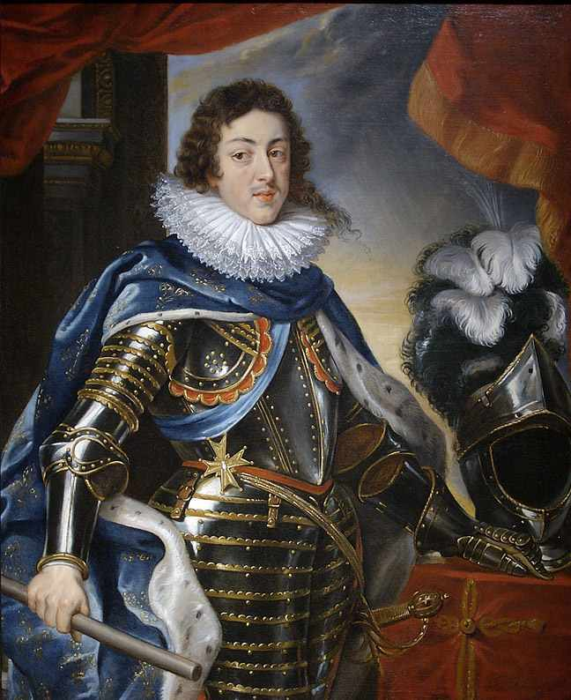
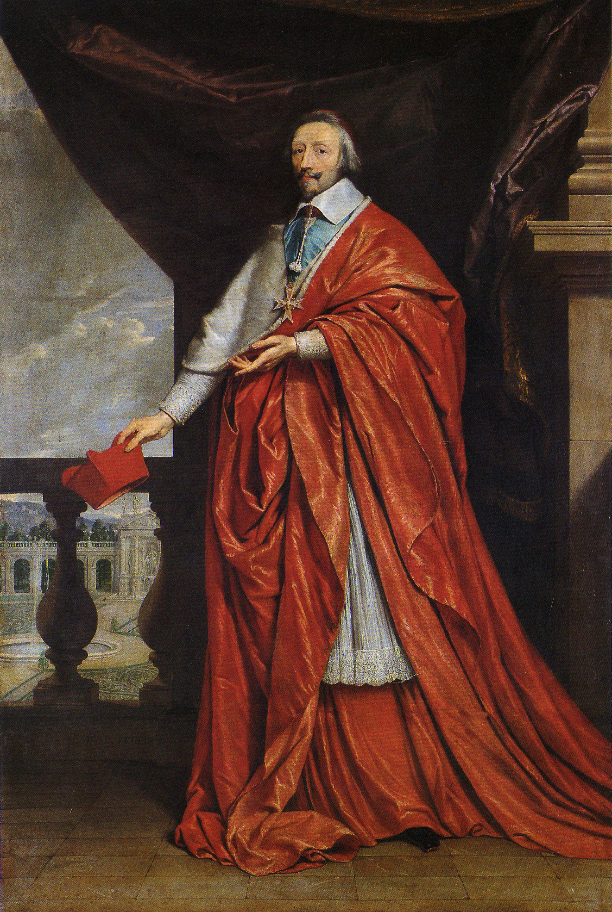
Louis XIII and Cardinal Richelieu

