Slide 1
IB Psychology 11.20.17
Turn in:
Nothing
Take out:
Notes, notes, notes
Today’s Learning Objectives:
I can write an impactful introduction in order to successfully preface my Internal Assessment.
Today’s Agenda:
More Internal Assessment!
Design, Participants, & Procedure
HW:
Design, Participants, & Procedures due Friday by EOC

Slide 2
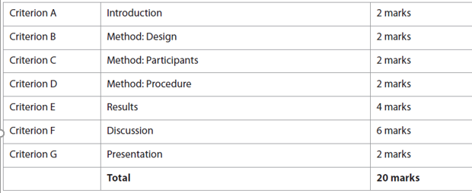
Components of the Internal Assessment:
Criterion & Marks available

Slide 3
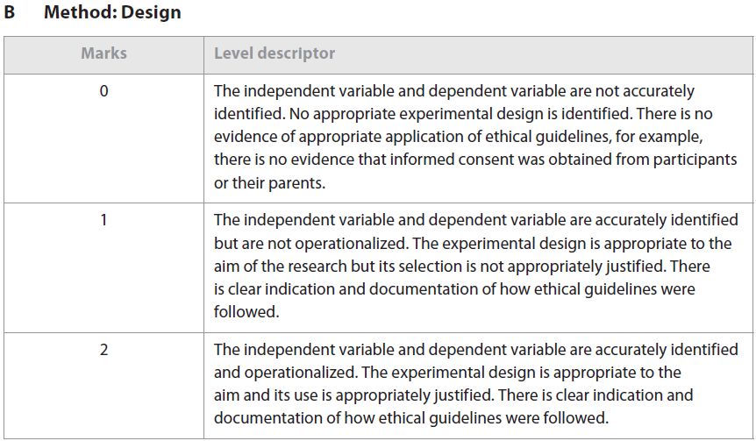
Components of the Internal Assessment:
Criterion B,

Slide 4
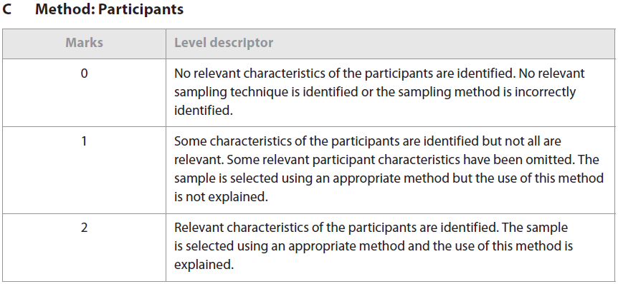
Components of the Internal Assessment:
Criterion C

Slide 5
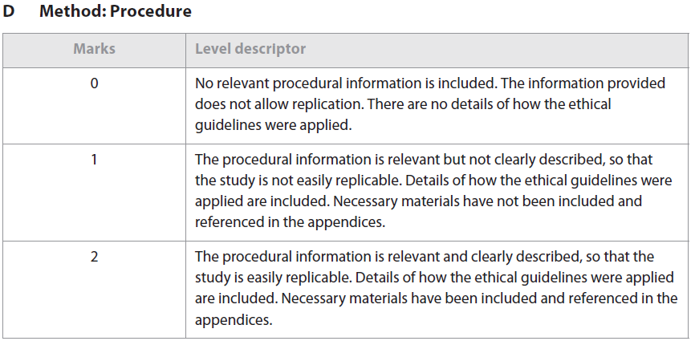
Components of the Internal Assessment:
Criterion D

Slide 6
Sections B & C Design & Participants (2 Marks each…)
Warning!!!
Many students earn 0 marks for sections B & C

Slide 7
Sections B & C Design & Participants
Replications (your experiment) should be done under “controlled conditions.”
In other words, don’t do it in the halls, or at the lunch tables…you will lose marks—possibly in procedure as well…

Slide 8
Sections B & C Design & Participants
The design and sampling method must be “justified…”
Why did you choose your design and sampling method?!?

Slide 9
Sections B & C Design & Participants
You must identify and operationalize your IV and DV.
Both need to be defined…you must state explicitly how you will measure the DV.

Slide 10
Sections B & C Design & Participants
Ethics:
You must discuss them, and include documentation…If (even though you shouldn’t…) you have any participants under 16, parental consent must be present for each…

Slide 11
Sections B & C Design & Participants
Ethics:
Debriefing notes must also be present…If not, regardless of the rest of your brilliance, it will result in ZERO marks for criterion B.

Slide 12
Section D Procedure (2 Marks)
Begin with a list of materials prior to the procedure…Should also refer to appendices.
What you need here is enough information for someone else to replicate the study...It may be bulleted, but keep formal writing in mind!

