Slide 1
10th World Studies 4.19.18
Turn in:
Nothing
Take out :
Planner/Calendar
NOTES & NOTE-TAKING DEVICE
Today’s Learning Objectives:
I can understand how Hitler’s rise to power impacted the culture of Germany and the population.
Today’s Agenda:
Enabling Act
Night of Long Knives
Nuremburg Laws
HW:
CRA & Questions
Enabling Act
Political Cartoons
Nuremburg Laws

Slide 2
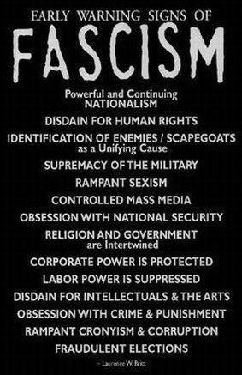
Powerful & Continuing Nationalism
Disdain for Human Rights
Identification of Enemies/Scapegoats (as a Unifying Cause)
Supremacy of the Military
Rampant Sexism
Controlled Mass Media
Obsession with National Security

Slide 3
Religion & Government are intertwined
Corporate Power is protected
Labor Power is suppressed
Disdain for Intellectuals & the Arts
Obsession with Crime & Punishment
Rampant Cronyism & Corruption
Fraudulent Elections

Slide 4
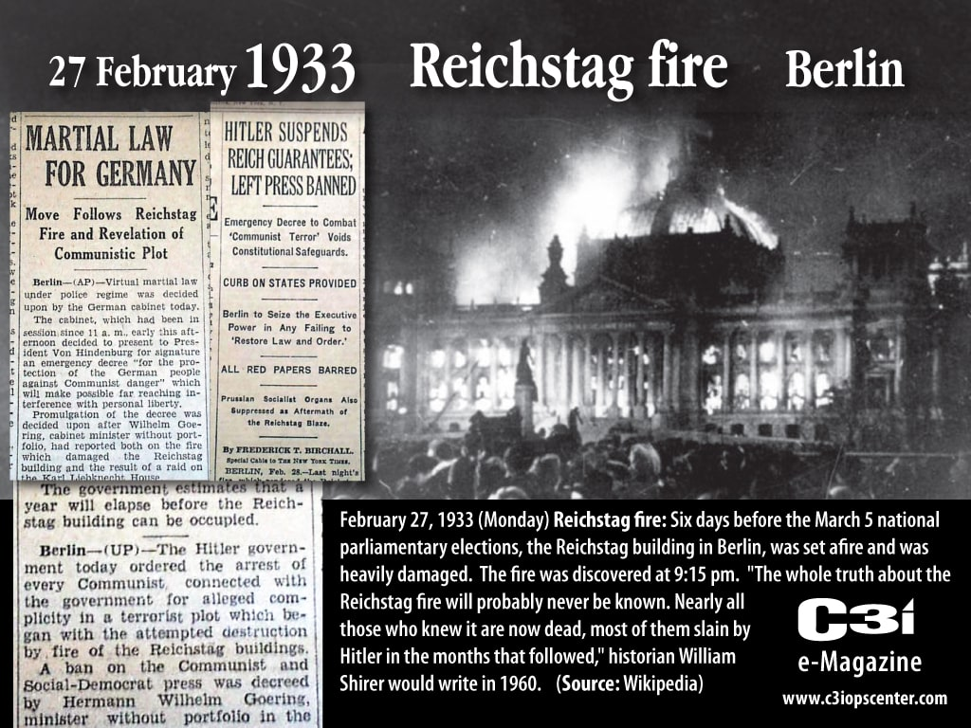
The Enabling Act (1933)
AKA: ‘Law to Remedy the Distress of People and Reich’
Hitler uses the Reichstag fire as a catalyst for MARTIAL LAW…and in times of emergency, of course the gov’t must protect the people from themselves…

Slide 5
The Enabling Act (1933)
AKA: ‘Law to Remedy the Distress of People and Reich’
Needed 66% of Reichstag present & 66% to vote in favor to change the Constitution…but new procedures put into place to get around this issue.

Slide 6
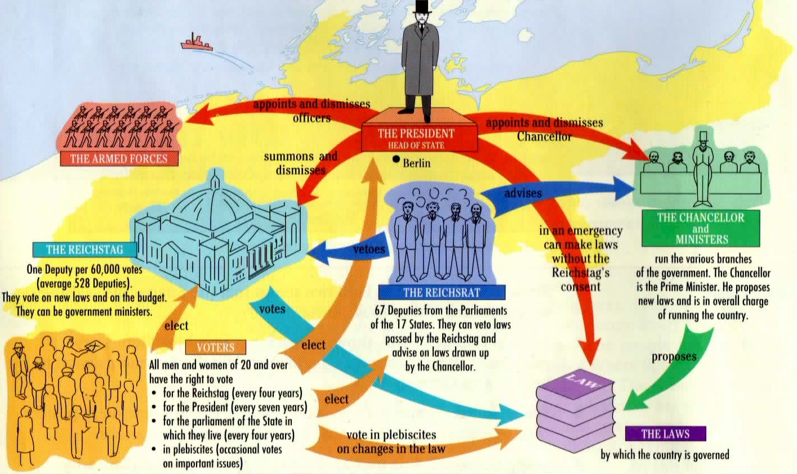
Germany’s Parliament System
AKA: ‘Law to Remedy the Distress of People and Reich’

Slide 7
The Enabling Act ( March 1933)
AKA: ‘Law to Remedy the Distress of People and Reich’
Vote was 444 to 94 (of those present…)
Legislative power was consolidated within the Chancellorship and Cabinet—they could pass laws
Presidential approval was also no longer needed
By July all political parties other than the Nazis were banned.
Also in July, the need for cabinet involvement was eliminated—now took about 24 hours for Hitler to have an idea and put it into LAW.

Slide 8
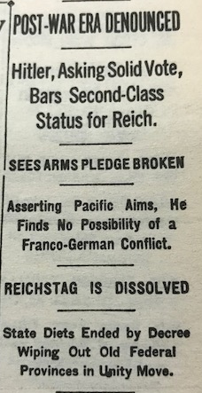
Other Actions Taken by the new Chancellor
October, 1933: Germany leaves the League of Nations and arms discussions…
--Reich will not be second class
--Reichstag is dissolved

Slide 9
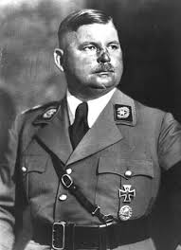
"Nacht der Langen Messer“ The Night of Long Knives (1934)
Ernst Rohm:
leader of the SA (Sturmabteilung= “Stormtroopers”)
AKA the “Brown Shirts”
Believed to be plotting against Hitler over a period of time
In the film, the scene where Hitler is telling Rohm, the SA would never be part of the regular army…”they’d rather flag the Nazi flag…”
Hitler made a deal with the 2 million or so SA members…and they did just that.
Think of this as Hitler’s “Purge”—approximately 200 of once high-ranking officials and friends of the Nazi party were eliminated.
Now, Hitler could rule without much resistance…

Slide 10
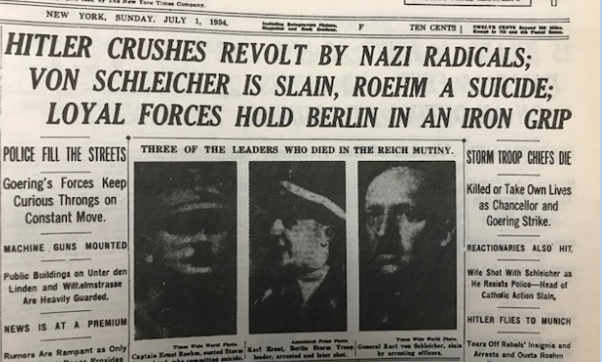
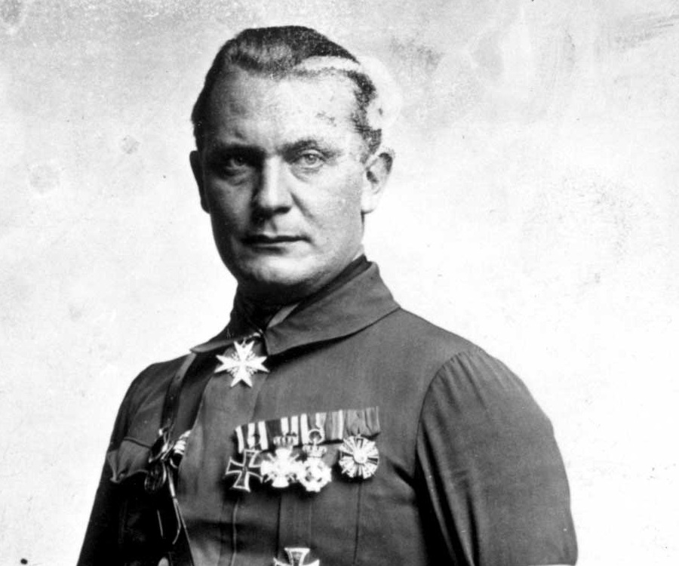
Nacht der Langen Messer June 30, 1934
Herman Goering (Göring)
The world sees this happening…
“…as Chancellor and Goering Strike.”

Slide 11
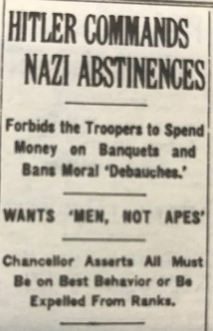
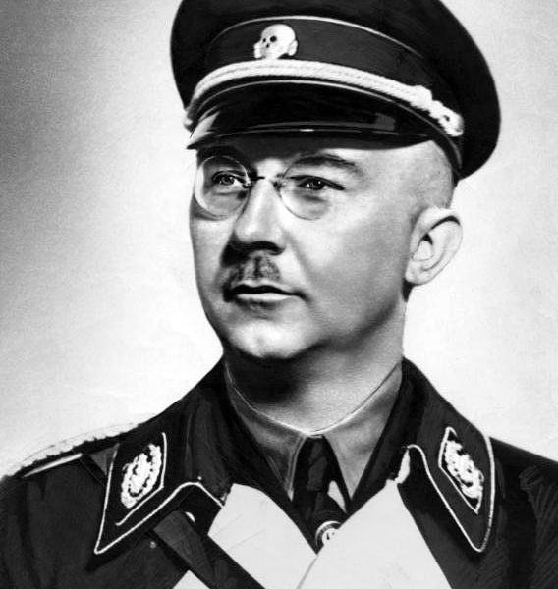
Nacht der Langen Messer June 30, 1934
"In this hour I was responsible for the fate of the German people, and thereby I become the supreme judge of the German people. I gave the order to shoot the ringleaders in this treason."
Military force/power transfers from the SA to the SS (Schutzstaffel): “Protection Squad” under Himmler

Slide 12
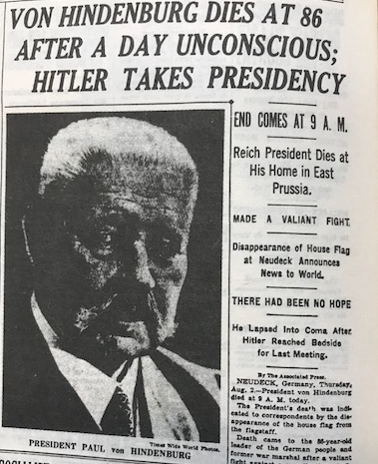
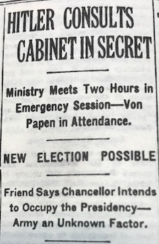
Other Actions Taken by the new Chancellor
Upon the death of Hindenburg, Hitler moves to consolidate power by combining the offices of President and Chancellor…

Slide 13
The Enabling Acts, Political Cartoons, The Nuremberg Laws, and formulating thoughts…
Please CRA each (yes, you can “read” cartoons…) of the pieces…Individually.
Why is the way in which Hitler comes to power:
Similar/different to other powerful leaders we’ve studied
How will the other nations in Europe/world respond? Are they even aware?

