Slide 1
10th World Studies 4.23.18
Turn in:
Nothing
Take out :
Planner/Calendar
NOTES & NOTE-TAKING DEVICE
READINGS FROM LAST WEEK…
Today’s Learning Objectives:
I can understand how Hitler’s rise to power impacted the culture of Germany and the population.
Today’s Agenda:
Anti-Semitism & The Nuremberg Laws
HW:
NONE—if you participate…

Slide 2
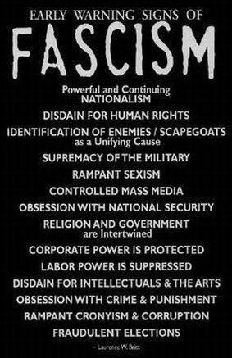
Powerful & Continuing Nationalism
Disdain for Human Rights
Identification of Enemies/Scapegoats (as a Unifying Cause)
Supremacy of the Military
Rampant Sexism
Controlled Mass Media
Obsession with National Security

Slide 3
Religion & Government are intertwined
Corporate Power is protected
Labor Power is suppressed
Disdain for Intellectuals & the Arts
Obsession with Crime & Punishment
Rampant Cronyism & Corruption
Fraudulent Elections

Slide 4
What questions do we have thus far?

Slide 5
The History of Anti-Semitism
The history of Anti-Semitism can be broken into 3 main periods of history:
Ancient/Roman times
Christian/Medieval period
Modern Anti-Semitism

Slide 6
Why have people always hated the Jews as a group? Several potential “reasons”…
The Jews have always been monotheistic
The Jews have always lived according to their laws and not mixed with others
The Jews are blamed for killing Christ

Slide 7
Ancient/Roman Times
Jews were persecuted by the Romans for not accepting their gods
Jews refused to support the Roman government
Jews revolted against the Romans
Rome crushed the rebellion and forced the Jews out of Palestine in 70C.E.

Slide 8
Christian/Medieval Era
Jews were hated by Christians
“Blood Libel”– using the blood of Christian children during the celebration of Passover
“Host desecration”—renewing the agony of the Passions
Black Death—some communities remained virtually plague-free

Slide 9
Jews were separated in Christian Society
Creation of ghettos for the Jews “safety”
Usury
Job opportunities were limited for Jews
The Inquisition– used to root out heresy
Auto de fe
Conversos and Maranos—those that professed conversion, but continued to live according to Jewish tradition/religion.

Slide 10
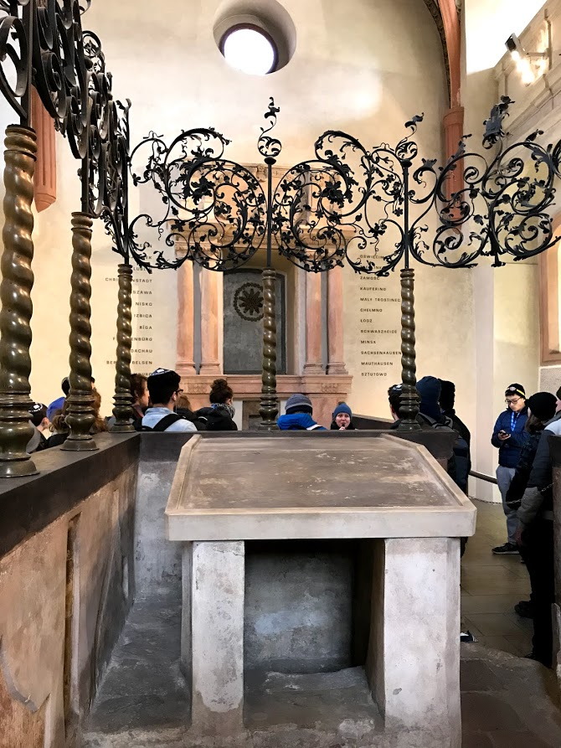
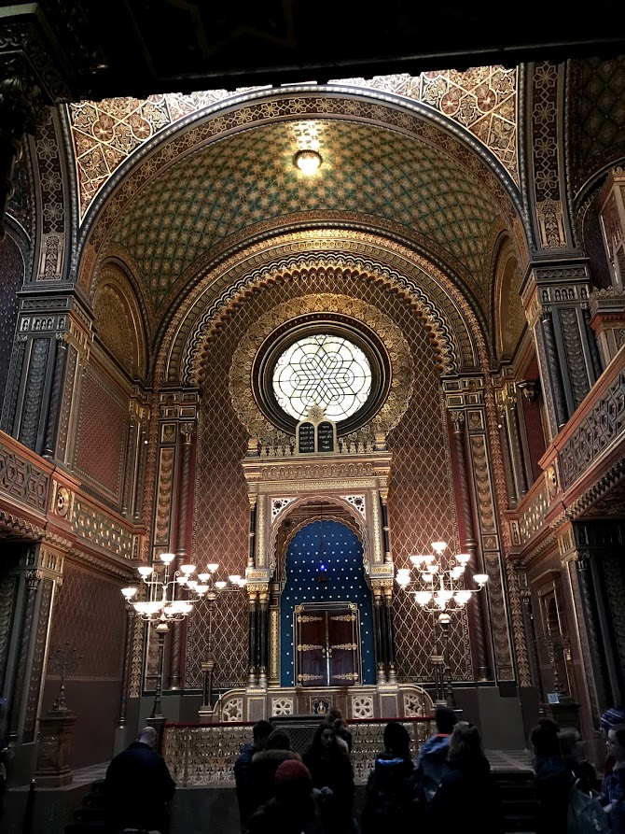
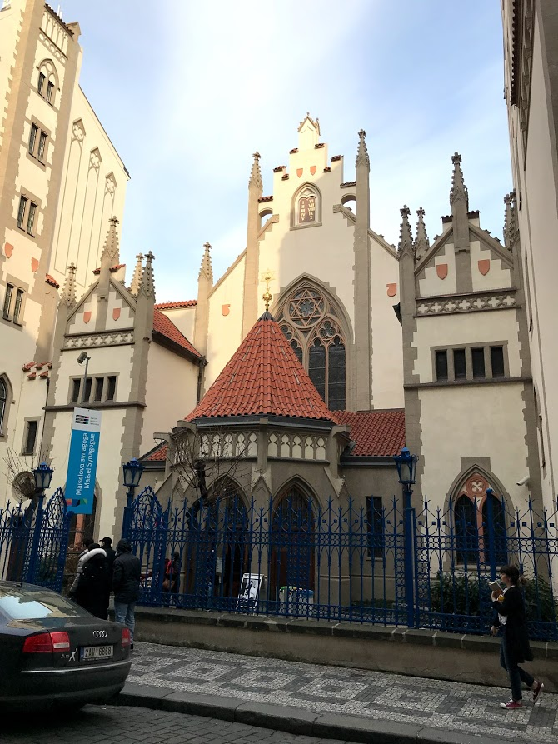
Jews were separated in Christian Society
“Modern Europe” still segregated Jews in most cities.
Many were not allowed to live or own property (if at all…) outside these designated areas…
Prague, Czech Republic (Czechoslovakia) “Jewish Quarter”

Slide 11
The Ghetto
Creation of ghettos for the Jews “safety”
ghetto (n.) 1610s, "part of a city in which Jews are compelled to live," especially in Italy, from Italian ghetto "part of a city to which Jews are restricted," of unknown origin.
The various theories trace it to: Yiddish get "deed of separation;" a special use of Venetian getto "foundry" (there was one near the site of that city's ghetto in 1516);
or Italian borghetto "small section of a town" (diminutive of borgo, which is of Germanic origin; see borough).
Extended by 1899 to crowded urban quarters of other minority groups (especially blacks in U.S. cities). As an adjective by 1903 (modern slang usage from 1999).
Ghetto-blaster "large, portable stereo cassette-player" is from 1982.

Slide 12
The Nuremberg Laws
Notes:
Law and Holocaust in same sentence is an oxymoron. Dry Tears survivor testimony “No one ever died illegally in Auschwitz”
The law became a weapon. They used legislation to dehumanize the Jews.
In Nazi rule, legislation was executive orders for 12 years. The Reichstag passed 4 laws in the Hitler era. September 15, 1935 3 of these laws were passed that became known as the Nuremberg Laws.
Under Hitler, most things done under executive order. There was no discussion or debate. They wrote a few paragraphs and signed off on it. Over 4,000 executive orders were signed in the first 3 years of Nazi rule and by the end there were thousands.
Over 2,000 executive orders that were aimed directly toward Jews.
Before 1933, passing laws involved the President, the Cabinet, and the Reichstag. The Reichstag delegated their power to the Cabinet.
Fuhrer Princep took out the cabinet and it was just the Fuhrer implementing orders. There was no separation of powers. By 1937 the cabinet no longer meets.
The Nazi’s had a contempt for law. Judges had to meet the needs of the hour or they would be threatened and would be removed from office.
Albert Speir, minister of munitions, he got 20 years at the Nuremberg trials. He wrote his memoirs. If Hitler had one true friend, it was him.
Not a single treaty that Germany encountered under Rippentrough that Germany did not violate and Hitler laughed. Hitler was given a special box to collect the treaties that he had broken.
1939- massive number of laws for less than ½ of the German population.
Law is an underlying philosophy of a belief system.
Jan. 31, 1933- 1 day after Hitler is sworn in. What legislation is needed to implement Mein Kampf?

Slide 13
What Rights Are Most Important To Me?
Date/marry whomever you choose | Swim and play in a public swimming pool or park | Eat what you want according to taste and religious custom
Live in a neighborhood of your choice | Leave your home whenever you choose | Shop at stores and businesses of your choosing
Go to a public school close to home | Be able to own a pet | Vote
From Echoes and Reflections Curriculum
Notes:
Rank the following in order of importance to you, with #1 being the most important and #2 being the least important.

Slide 14
The Nuremberg Laws
Were passed Sept. 15, 1935
Law for the Protection of German Blood and German Honor
Regarded German marriage
The Reich Citizenship Law
Designated Jews as subjects
Notes:
The Nuremberg Race Laws of 1935 deprived German Jews of their rights of citizenship, giving them the status of “subjects” in Hitler’s Reich.
These were the first two laws

Slide 15
The Nuremberg Laws
Those laws soon followed by “The Law for the Protection of the Genetic Health of the German People.”
Required medical examination for all persons wishing to marry
After this they could get a “Certificate of Fitness to Marry.”
History of Eugenics? Forced sterilization, etc. dating back to at least 1933 (See Buck v Bell (1927))
Notes:
Those laws were soon followed by “The Law for the Protection of the Genetic Health of the German People, which required all persons wanting to marry to submit to a medical examination, after which a “Certificate of Fitness To Marry” would be issued if they were found to be disease free. This certificate was required in order to get a marriage license.

Slide 16
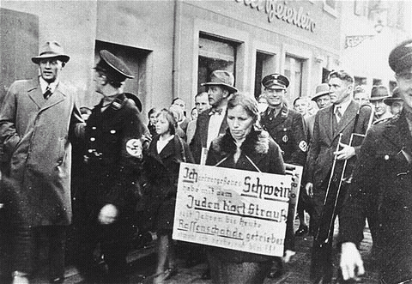
Ich= “I”
Schwein= “Swine”
Juden hort= “Jewish horde”
Reffenschande= “chame carrying”

Slide 17
The Nuremberg Laws
After the Nuremberg Laws of 1935, a dozen supplemental Nazi decrees were issued that eventually outlawed the Jews completely, depriving them of their rights as human beings.
8 (10) stages of genocide???
Classification
Dehumanization
Polarization

Slide 18
Themes of the Nuremberg Laws
Theme 1: Definition of who is a Jew
A full Jew is anyone with three Jewish Grandparents
First Class Mischlinge (“mixed race”)- two Jewish Grandparents but did not practice Judiasm or have a Jewish spouse
Second Class Mischlinge- one Jewish Grandparent
Notes:
Had to know who was a Jew and who wasn’t so you knew who to attack
At first thought there was a unique Jewish blood type that could be identified. When their pseudo science collapsed, they had to find a different way to identify Jews
The Nuremberg Laws had the unexpected result of causing confusion and heated debate over who was a “full Jew” The Nazis then issued instructional charts to help distinguish Jews from Mischlinge (Germans of mixed race) and Aryans. The effect of this legislation was that Jews were defined as a separate and inferior race. It was a devastating blow.
In the end, people with even one Jewish grandparent were considered technically Jewish. According to the Nuremberg Laws, even Roman Catholic priests and nuns and Protestant clergy were were converts to Christianity, or whose parents had converted, were considered Jews.
On a personal level, people went to bed Christian and woke up a Jew.
They Nazi’s didn’t have to prove that you were a Jew. You had to prove that you were not a Jew.

Slide 19
Themes of the Nuremberg Laws
Theme 1: Defining who is a Jew
Seven documents were required to prove German descent
Your birth or baptismal certificate, certificates for both parents, and certificates for all four grandparents.
Why would this be important? It doesn’t bar anyone from “proving” anything does it?
Notes:
Church offices, which had registered all births until 1875, were besieged with requests for documents proving German ancestry. A new cottage industry sprang up as hordes of “licensed family researchers” offered their services to anxious clientele of Germans afraid of a skeleton in the family closet.
A lot of people sought fake birth and baptismal certificates

Slide 20
The Nuremberg Laws
Theme 2: Stripping Jews of Rights of Full Citizenship
What really constitutes a “citizen?” (II.1)
Notes:
Jews were turned into lower citizen and then non-citizenship
Only citizens had the highest level of protection

Slide 21
The Nuremberg Laws
Theme 3: Racial Purity
Prevent intermarriages and extramarital relationships between Jews and non-Jews.
Jews could not hire female help under the age of 45
Notes:
All of humankind is divided into racial groups in a hierarchy. History is a struggle to prevent racial pollution of the Aryans by the Jews.
This law forced the dismissal of help and led some people to divorce their spouse.
On April 29, 2945 Hitler is in the bunker. Germany has been defeated and the 1,000 year Reich has crashed after 12 years. One day before Hitler commits suicide, he marries Ava Braun. Their marriage certificate says they are of pure Aryan blood. Shows that even when close to death, Hitler is interested in pure blood.
There is an original recording of Goering reading the Nuremberg Laws at the Reichstag with Hitler watching. Called Seventh Party Congress film clip.

Slide 22
The Nuremberg Laws
Theme 4: Deprivation of Income Capacity
Notes:
Jews are thrown out of work and many businesses and occupations are closed to them. Dry Tears survivor testimony “No one ever died illegally in Auschwitz”
Objective was to drive them out of society and force them to emigrate. Up until Nov. 1941, a Jew could get out of Germany.
Also forced them out of influence- can’t trade ideas at wok, also dehumanized them.
Began in April 7, 1933 with the Civil Service Law- included Dr.’s, lawyers, universities. There were some exceptions. Changed their lifestyle- told “They can starve” This was hard for people with non-portable professions. Law is not a portable profession.
Between Dignity and Despair- focuses on women in Nazi Germany. Women are now forced to earn the income because it is easier for them.

Slide 23
The Nuremberg Laws
Theme 5: Taking Property
Jews are forced to register their assets
Forced selling or “Aryanization” of property
Notes:
This policy was designed to deprive Jews of their assets. Had to register stocks, bonds, jewelry.
Jews were law abiding citizens and registered.
IBM helped with programming to help keep track of registered items.
Forced selling of Jewish property was called “Aryanization.” Raul Hindberg has contract for forced sale of trademarks, inventory, land, buildings. This is all part of the value, but when they sold the property, they based the value only on the inventory. They didn’t include the land and building value. In order to reduce the price, they sold off some inventory prior to the sell.
Karl Joel, grandfather of Billy Joel, had a large department store in Nuremberg. A Jew tries to buy him out for 10 cents on the dollar. This was a good deal compared to what was going on. He sells and goes to Switzerland. He is told that if he wants his money, he will have to come back to Berlin. This is a death sentence. He goes to Canada and later to Long Island. In 1947, Karl goes to Germany and finally in 1958 Karl Joel gets his money.
They also find ways to levy other taxes against the Jews. The Jews are collectively given a fine of 1 billion Reichmarks for Kristallnacht so they put a tax on each individual. There is an emigration tax Jews have to pay in order to leave. They also put a tax on all goods taken out of the country.
When a Jew died, the Reich was the heir of that Jew. What little was left when a Jew died went to the Reich.

Slide 24
The Nuremberg Laws
Theme 6: Exclusion from Educational Opportunities
Notes:
Small quota at first 1%-5% could go to school. Later none were allowed to go to school.
When removed from the public school, many went to Jewish schools, but later all of these were closed also. It was an “intellectual death sentence” The doors of opportunity close. “Can’t go to school today, but I went to school yesterday” How do you explain that to a young child? It is out of my hands, the law is the law.

Slide 25
The Nuremberg Laws
Theme 7: Branding- force Jews to proclaim to the world they are Jewish
Adopt the middle names of Sarah and Israel
Have to carry identity papers that are stamped with a J
Yellow star- Must be sewn on the left side of all garmets
Notes:
Story of one person who absent-mindedly went out without their star and was brought back to the family in an urn.

Slide 26
The Nuremberg Laws
Why must this be done legally instead of by custom?
Law is neutral- it depends on whose hands it falls into that determines if it is good or bad.
“not all that is legal, is moral”
Notes:
Jews were brought up in a climate of obediance and observance of the law.
If you were on a train and all of the seats were full and an Aryan pulled a Jew out of his seat, Goebbels wanted to effect the surrounding passengers so they would help pull the Jew out of his seat for the Aryan, or at least, not protest the action because it was the law.
Implications for today:
1. P. 722 of Mein Kampf- Hitler talks of using poison gas to kill Hebrews. Says if had killed 15,000 Jews with poison gas it might have saved Germany the embarrassment.
2. If had taken Fuhrer at his word in Mein Kampf there was warning chapter of Nation and rest. Very few step up, even as far as judges
3. Didn’t have to amend the Weimar Constitution because of Article 48- it is martial rule, not martial law.
4. Mein Kampf- wanted to come to power legally within the frameword, but once in power, he suspended the legal framwork.
5. How is the Patriot Act different: a. We still have regular elections. For 12 years the Nazi’s did not have elections and they couldn’t do anything about it. B. We still have separation of powers and checks and balances (judicial review) where they did not.
Democracy is the worst example of government except for all of the others.
Germany is sensitive to overseas opinion. In Germany Speaks- they say there are not a lawless society.

Slide 27
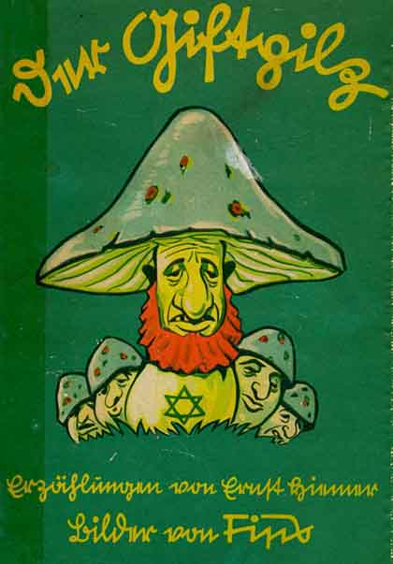
Der Giftpilz: “The Poisonous Mushroom”
First published in 1938 as a children’s book.
To be fair, not all within the Nazi party thought highly of the work…
Propaganda Minister Joseph Goebbels did not think a lot of the book. In his diary entry for 29 May 1938 he writes: “Streicher has published a new children’s book. Terrible stuff. Why does the Führer put up with it?”
In your groups: each of you read one of the selected sections…follow a similar pattern we looked at last night.
Context of the story—the meaning
What’s the purpose?
What deeper questions do you have?

Slide 28
Modern Anti Semitism
With the Enlightenment Jews were no longer seen as outsiders
Dreyfus Affair in France
Social Darwinism
Pogroms in Russia
Zionism

