Slide 1
IB Psych 9/12/17
DUE:
1.1-1.2
Take out :
Planner
Notes/Paper
Note-taking devices
Today’s Learning Objectives:
I can make a determination as to the degree of “science” in Psychology.
Today’s Agenda:
Intro to course, cont.
“Exercise and Psychological Health” w/questions
HW:
Finish reading and questions…

Slide 2
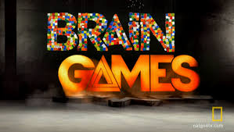
What do you think???
5. “Brain games do NOT make you smarter.”
True! More than 8600 people were asked to play online brain games to improve their memory, reasoning and other skills for at least 10 minutes a day, three times a week.

Slide 3
What do you think???
5. “Brain games do NOT make you smarter.”
They were then compared to more than 2700 people who didn’t play any brain games, but spent a similar amount of time surfing the net and answering general knowledge questions. Researching found no distinct difference between the groups.

Slide 4
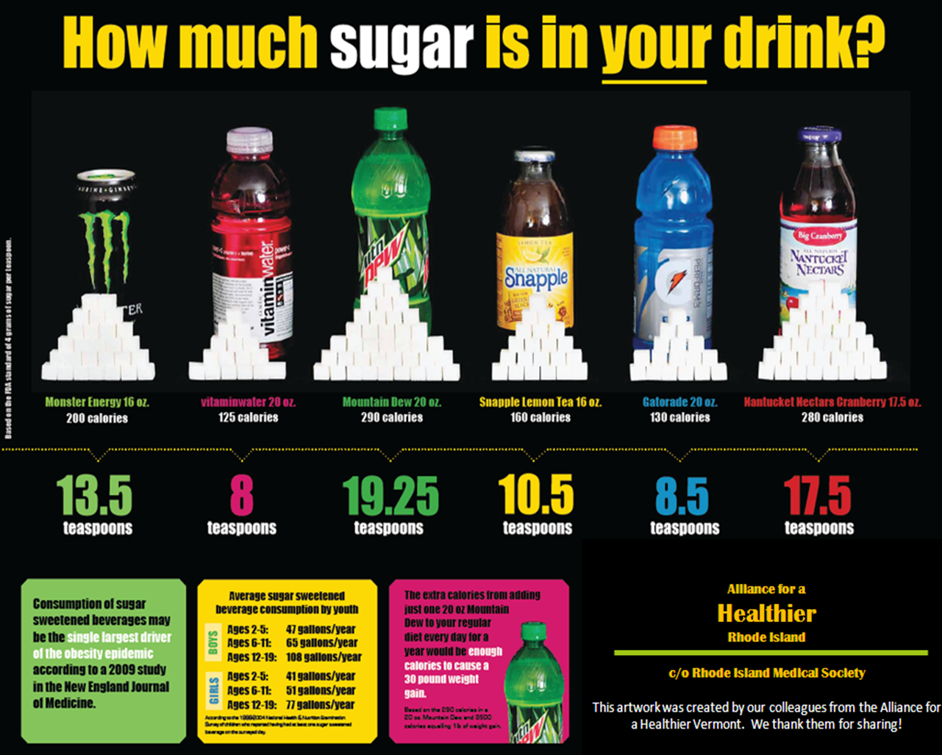
What do you think???
6. “Sugar makes kids hyper.”
Ask your parents…numerous studies show sugar doesn’t affect behavior, but most parents would disagree…In one study, parents were told their kids had sugar and they were more likely to report problem behavior—in reality, the kids had consumed a sugar-free drink.

Slide 5
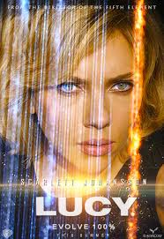
What do you think???
7. “You only use 10% of your brain.”
Brain scans have shown that no matter what we’re doing, our brains are always active. Some areas are more active at only one time than others, but unless we have brain damage, there is no one part of the brain that is absolutely not functioning at any given time…

Slide 6
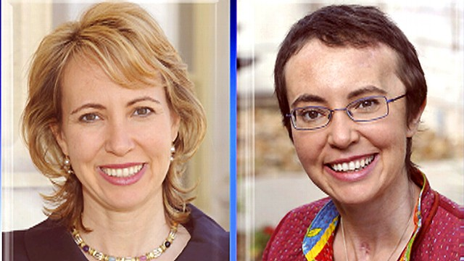
What do you think???
8. “If a brain is damaged, it can in some cases fix itself...”
Patients surprise doctors all the time and exceed expectations of what they’re able to do days, months, and even years later. Not all brain damage is permanent.

Slide 7
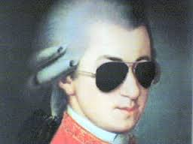
What do you think???
9. “Listening to Mozart makes you smarter.”
Not exactly. There is currently no scientific information to prove that listening to Mozart, or any other classical music makes people “smarter.”

Slide 8
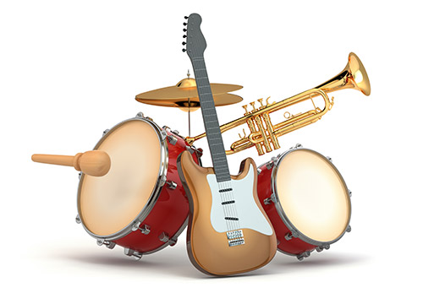
What do you think???
9. “Listening to Mozart makes you smarter.”
One researcher even said the money spent by this study might be better spent on musical programs—there is some evidence to suggest that learning an instrument improves concentration, self-confidence, and coordination.

Slide 9
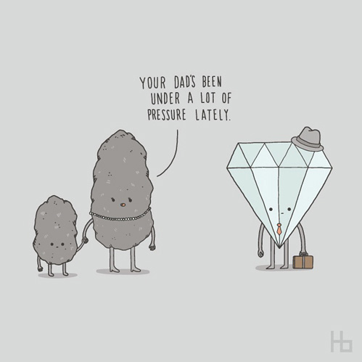
What do you think???
10. “Your brain works better under pressure.”
Not exactly…A chronic over-reaction to stress overloads the brain with powerful hormones that are intended only for short-term duty in emergency situation. Their cumulative effect damages and KILLS brain cells.

Slide 10
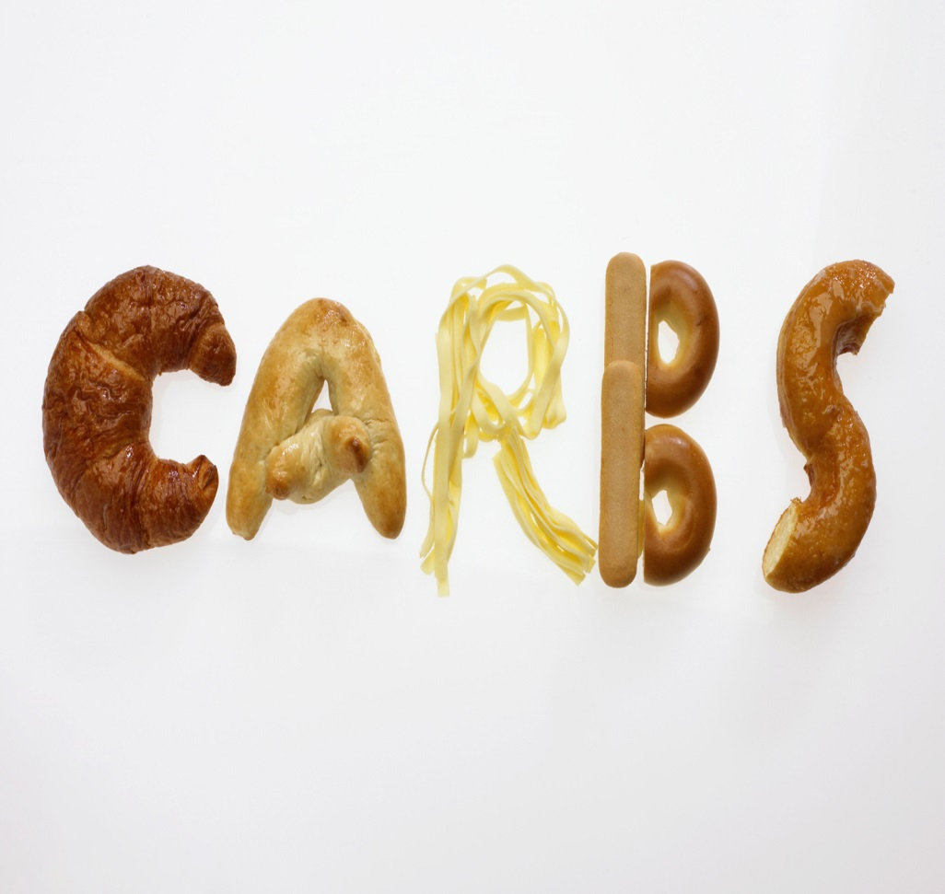
What do you think???
11. “Eating carbohydrates before a test could hurt your concentration..”
Partly true…Carbs that are high in starch (potato/pasta) or sugar can give you a boost of energy which will soon fade and leave you less concentrated towards the end of your exam. However, not all carbs are bad for you. Good carbs include whole grains…

Slide 11
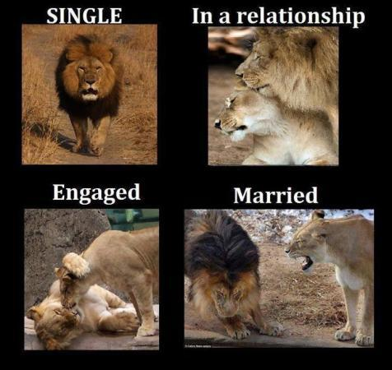
What do you think???
12. “Married couples have better sex lives than single people.”
Well, define “better…” Married people typically engage more often in any given year than single people. 43% of married men reported more than once per week, while only 26% of single men reported the same frequency.

Slide 12
So, what’s the point???
How do we “know” what we “know?”
Do we have “proof?” If not, how might we go about testing and measuring our theories and predictions?
As we begin to look at the design of studies, be on the look out for strong as well as questionable design…

Slide 13
Review of a study… “Exercise and Psychological Health”
As you read…
How reliable does the information from the study seem?
What strengths do you see?
Is there any weakness evident?
When finished, respond (to the best of your ability…)to the questions at the end of the reading…We’ll be using these tomorrow in class.

