Slide 1
World Studies 10 9.18.17
Turn in: Nothing
Take out:
Writing Implement
The start of your notes…
Today’s Learning Objectives:
I can describe what changes took place leading to the Middle Ages
Today’s Agenda:
Europe after Charlemagne
Feudalism
HW:
CRA 7.2 w/definitions & chart

Slide 2
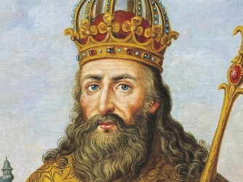
Europe After the Fall of Rome
Charlemagne
Grandson of Charles Martel (“The Hammer”) [defeated the Muslims—Battle of Tours, 732]
Briefly united western Europe
December 25, 800—Pope Leo III crowns him Emperor of the Romans (Christendom)
Establishment of the HRE—Holy Roman Empire
Everyone “safe” until…wait for it

Slide 3
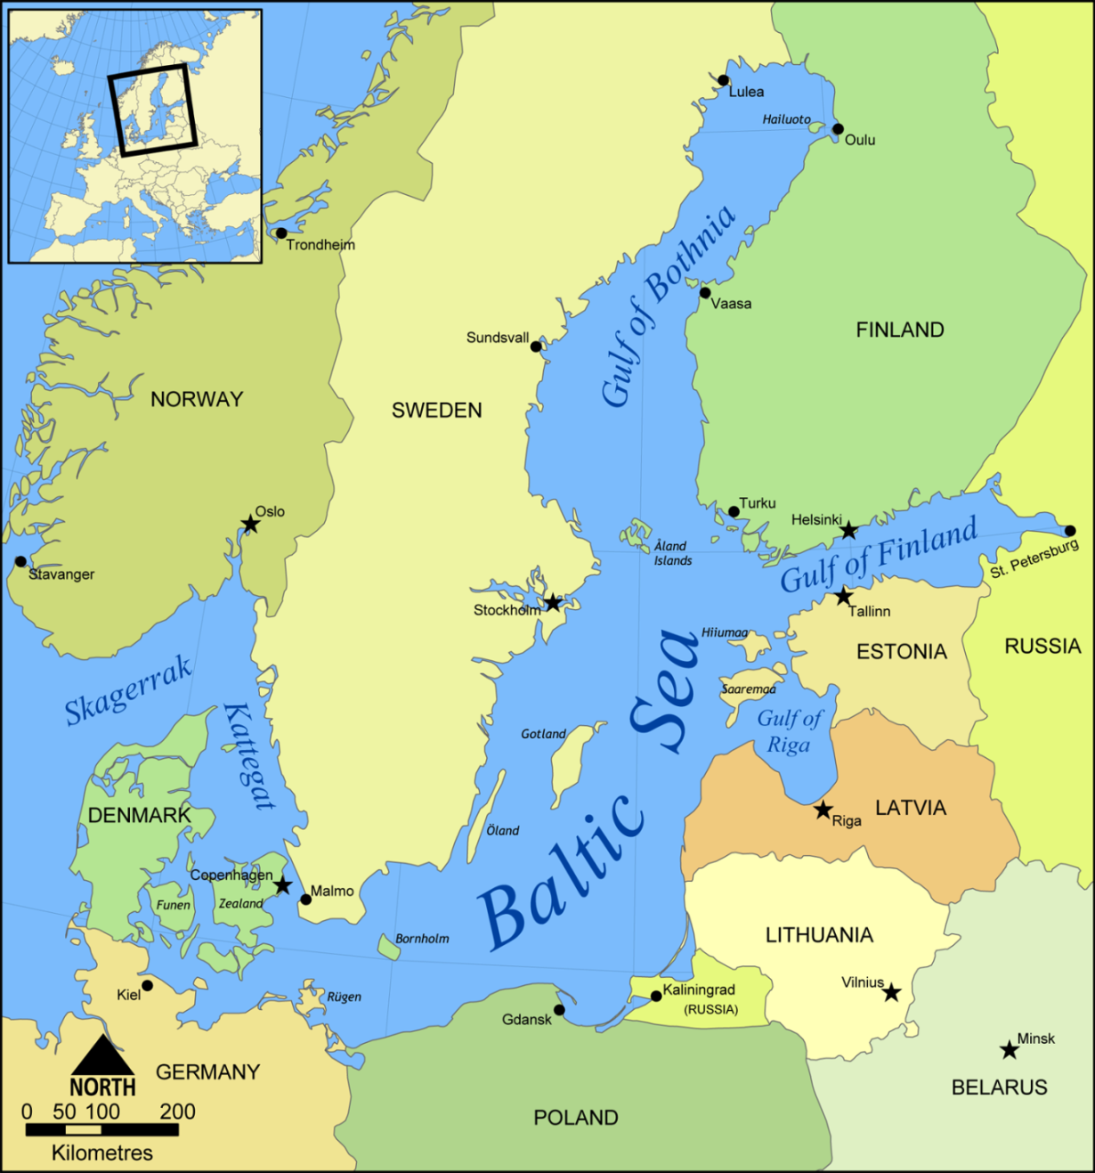
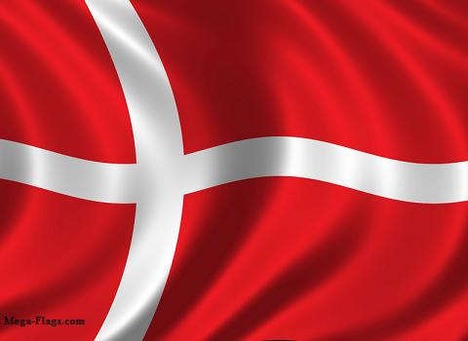
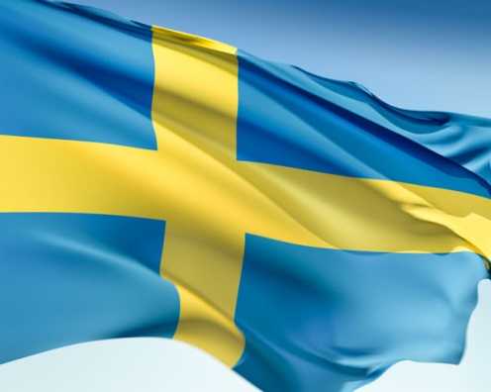
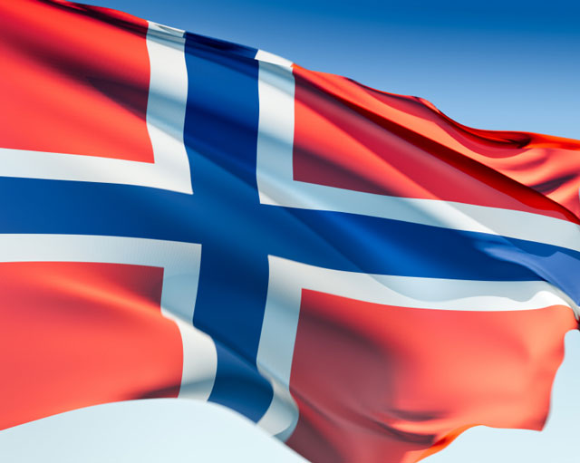
The Vikings

Slide 4
Vikings
Seafaring warriors from Scandinavia
Around 800-1000 Europe generally warms up
Leads to more food in Northern areas MORE FOOD=MORE PEOPLE
Scandinavia gets too crowded and warrior culture leads to looking for new places to conquer
Conquering turns to raiding = Vikings
Attacks occur all over Europe→ records exist from Britain to Constantinople

Slide 5
Vikings
Attacks are common and random smash and grab jobs
Indiscriminate in age, gender, area, religion or social status
Incredibly quick and brutal
Not just on coast (boats could sail in 3 feet of water)
Almost invincible (even battled Charlemagne to stalemate)

Slide 6
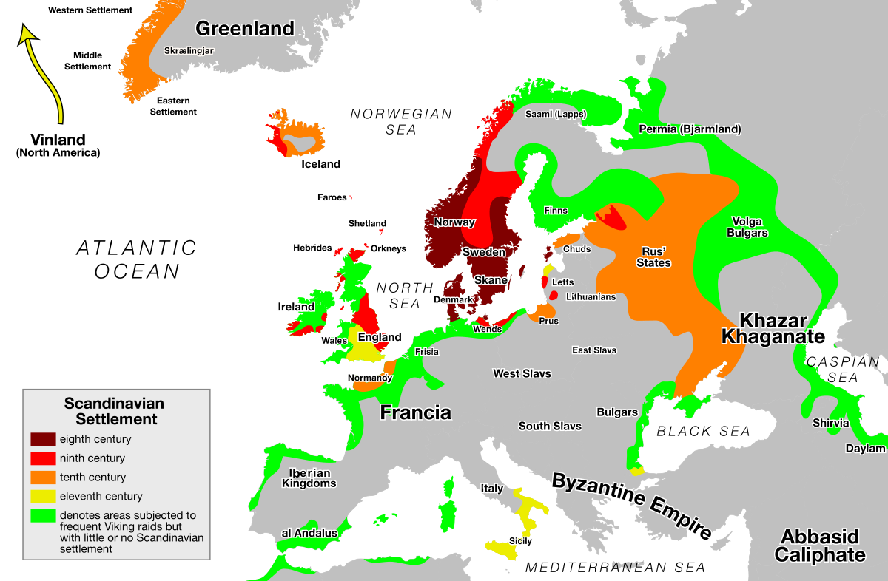
Vikings
Eventually settle down when the King of France gives the Vikings some land to stop attacking him
Founded Normandy (Land of the Northmen) as some stayed behind “wintering” and colonized…

Slide 7
Vikings
Beginning of Feudal system
Feudal: "pertaining to feuds," estates of land granted by a superior on condition of services to be rendered to the grantor, from Medieval Latin feudalis, from feudum "feudal estate, land granted to be held as a benefice," of Germanic origin (cognates: Gothic faihu "property," Old High German fihu "cattle."
Not related to “feud.”

Slide 8
What have the Vikings ever done for us?
Foundation of feudal hierarchy and system
Solidify Christianity as the “in” thing in Europe
Changes their religion from pessimistic to optimistic
“Discover” Iceland, Greenland and N. America
Maybe got as far South as Massachusetts
12 man trial by jury
Staple of Anglo-American justice system
Become the modern English
Eventually Colonize north (York) in 800s-1000s and conquer south (London, etc.) in 1066
William “the Conqueror” (“the Bastard”, “of Normandy”)
Revolutionize shipbuilding theory
Fascinating Sagas (Legend/Epic Poetry combo)

Slide 9
What have the Vikings ever done for us?
Founded feudal hierarchy and system:
Please grab a WH text book
CRA 7.2
Utilize the chart in order to place “people” in the social roles that you believe best define them…as well as the societal arrangement.
Define the terms at the beginning of the section (from the text or other source…)

