Slide 1
10th World Studies 9.27.17
Turn in:
CSI: Skyline Outline TII.com
Take out:
Planner
Notes & note-taking devices
Today’s Learning Objectives:
I can describe how a mysterious illness began to spread across Europe in the late Middle Ages, and the impact it had on society.
Today’s Agenda:
More on the Church
The 100 Years War
Transitions
HW:
CRA “A Medieval Holocaust:” (Online…)

Slide 2
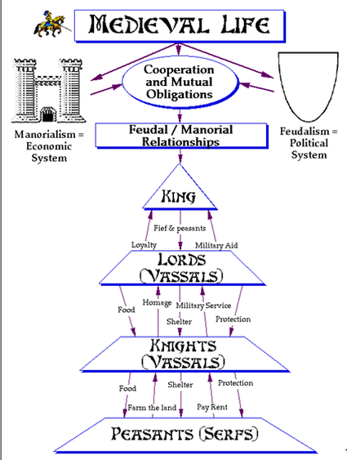
Good ol’ Feudalism…
Feudalism begins to fall apart (parts of it will exist for a long time, though)
We’ve discussed the Plague…now another major cause of its collapse…

Slide 3
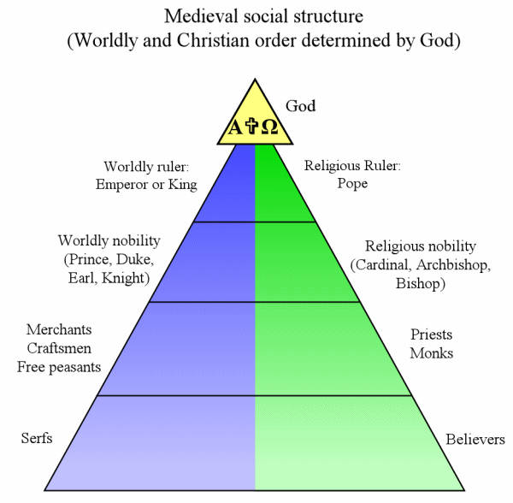
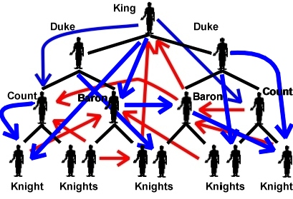
Feudalism begins to fall apart (parts of it will exist for a long time, though) We’ve discussed the Plague…now other major causes of its collapse…
What feudalism really looked like

Slide 4
Hundred Years War 1337-1453 France vs England
Begins as a dispute over succession rights to the French throne
Two main phases: England wins, then England loses
Ends with French kicking English out of continent
Importance:
Key changes in warfare, like the longbow, means the eventual end of knights
Strengthens French monarchy and weakens English nobles—king becomes more important
The concept of what we would now call “Nationalism” in England and France begins—associated with the monarch (king)

Slide 5
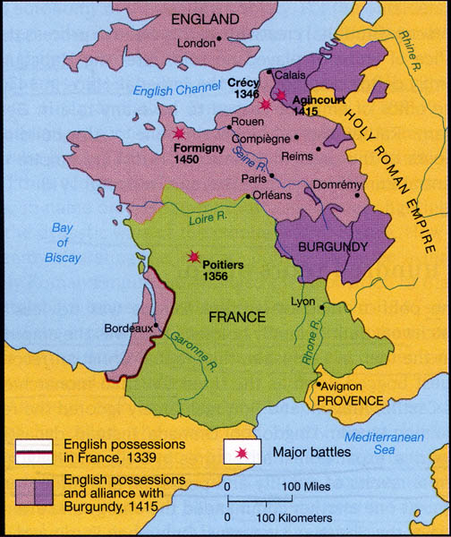

Slide 6
The Catholic Church is Corrupt…
very, very, VERY CORRUPT
As the one thing that ties Europe together, Catholic Church is everywhere
Controlled birth, death, marriage, salvation, education, etc.—Sacraments, yes???
Functioned like a massive multi-national corporation with its own state and army and the pope as its chief executive officer—treating Church happenings as a business…
Church officials from the pope on down break their vows – celibacy, poverty, and abuse power

Slide 7
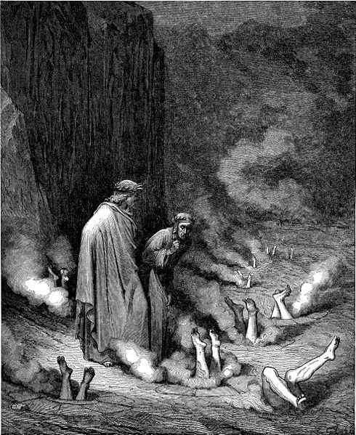
1200-1400 AD: Catholic Church Corruption
Many village priests married and had children-this was against Church rules
Bishops sold positions in the Church for money—a practice called simony
Church started to sell indulgences—get out Purgatory cards. Church getting rich off the poor!
Various groups revolt against the corruption of the church.

Slide 8
So, all of this corruption is really upsetting the order of the Medieval world…HIERARCHY makes sense as long as things run smoothly.
But, what happens when things begin to break down?
Retribution—the end of the world=Black Plague (Black Death)

Slide 9
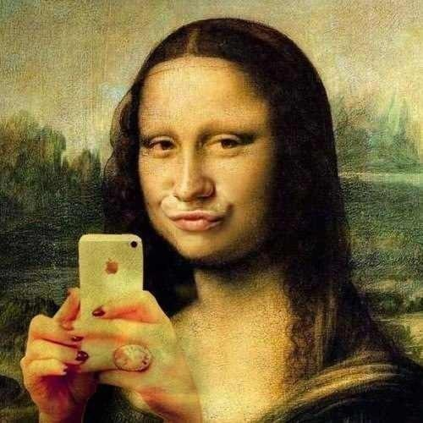
As Europe began to reform and rebuild itself it created a new society that would form the essence of the Modern Western World.
PLEASE GET OUT YOUR 3 COLUMN CHART FROM EARLIER THIS YEAR!!!

Slide 10
Renaissance 1300-1600
Word literally means “rebirth” (in French)
What was reborn was a Classical (Greek & Roman) ideas—art, architecture, philosophy, literature, finance, views of the world, etc. These had been suppressed by the Church (WHY??)
Began in Italy—mainly Florence—in 14th century, and moved to the rest of Italy—like Venice—in 15th century, as it spread through Southern Europe
Then spread to Northern Europe, through Holland and Flanders and onto England and Denmark and Sweden.
Mainly affected wealthy/educated people

Slide 11
Why Italy? Location. Location. Location
First European nation affected by the plague = first country to return to health and city life
Church structure particularly weakened by plague = more secular approach, more concern for the arts
Commercial Revolution. Wealthy due to trade from the Crusades = more exchange of people and ideas particularly from Islamic and Byzantine lands
Loose confederation of states = much easier to change one or two parts, like Venice or Florence than a whole country, like England
Had most of the classics buried in their land = easier to find through excavation and searching in the depths of churches

